Slide 1
MV Falls Prevention Coalition 2023
Agenda:
Matter of Balance (MOB) Update & Next Steps
Falls Prevention Month (September) Planning
“On Balance” Falls Prevention Booklet Ideas
July 25, 2023
&
LynnMarquedant@hamv.org
508-693-7900 ext. 502 or 508-341-5631

Slide 2
Matter of Balance (MOB) Update & Next Steps
By Aug 31st we will have delivered 3 MOB Sessions to rave reviews
33 attendees
Average age: 79
“Thank you for an extremely helpful and enjoyable program!”
“I looked forward to coming to class each week.”
Fall 2023 MOB Class – YMCA or Anchors? Dates?
MOB Train the Trainer – September 16-17 by Lori Perry – Who can we nominate?

Slide 3
Falls Prevention Month, Week, Day
FP Month: September 2023
Refresh and place Literature Packets at COAs, Libraries, YMCA, Chilmark Community Center, Airport Fitness, Chappaquiddick
FP Week: September 18-22, 2023
Host Tables at each COA & Libraries – Morning & Afternoon M-TH
Videos of Older Adult testimonials from UI MOB event?
FP DAY: September 22, 2023
Day-long Falls Prevention FAIR
Balance Screenings?
Location?
Giveaways – walker tips?
National THEME: From Awareness to Action

Slide 4
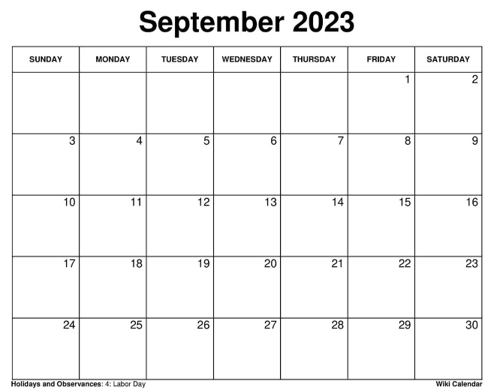
2023 Falls Prevention Month Calender
What should we do?
When?
Where?
Why?
How?
Lynn will fill in during meeting
FP Day
Falls Prevention Week

Slide 5
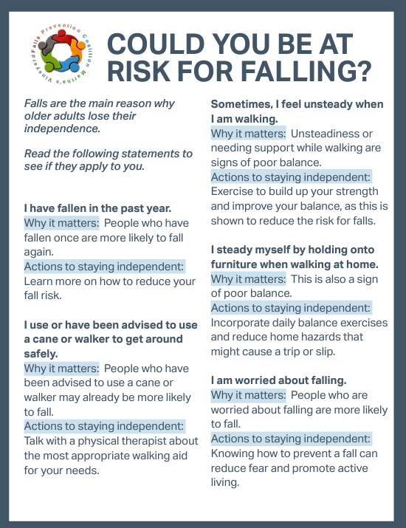
2023 Falls Prevention Month LITERATURE PACKETS & DIST LIST – what else?
Churches
NAACP
League of Women Voters
MV Garden Club
Tribe
UI COA
Tisbury COA
OB COA
Edgartown COA
WT Library
OB Library
VH Library
Edgartown Library
Aquinnah Library
Chilmark Library
YMCA
Chilmark Community Center
Food Pantry
Chappy (where?)
Airport Fitness
New
New
MOB Brochure – about the class and how to sign up
New
“On Balance” Resource Guide for Older Adults
A directory of tips, tools, programs, and professional guidance to help you reduce the risk of falling.
*Can we include “most accessible TrailsMV maps?”
HAMV Turns 10
Tree planting on Oct 10
Summit on Nov 14

Slide 6
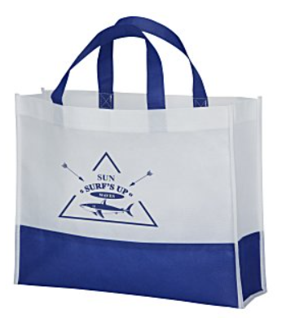
FP Coalition BAG Options
Another option – about $1.50/bag
HAMV should be able to cover this cost – need to check w/ C. Trish

Slide 7
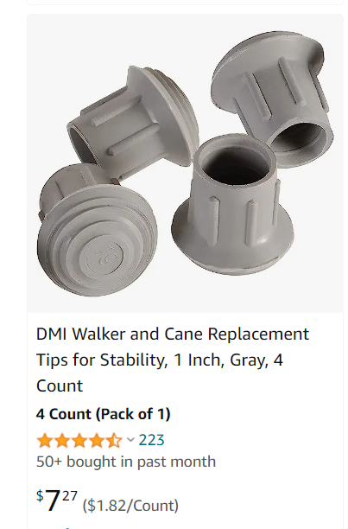
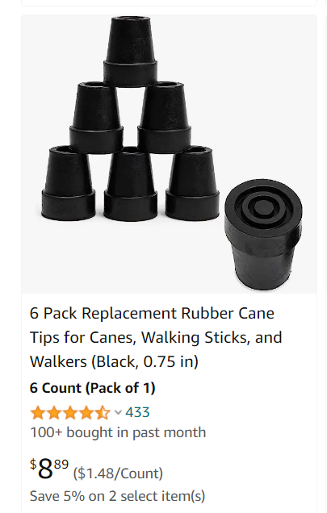
Walker Tips – where can we get good quality in bulk? Branded?
Need funding
MV Hospital have a source? Maybe already have some in a closet they could donate?

Slide 8
Action Items – Who wants to …
Help create new Lit?
Help assemble Lit kits?
Distribute Lit kits?
Host a table during FP Week? (A. McDonough at VH Library wants Mon afternoon)
Setup Balance Screening for FP Day? (Who? Where?)
Social media? Communications? Photography for future PR?
Create signage?

Slide 9
Appendix

Slide 10
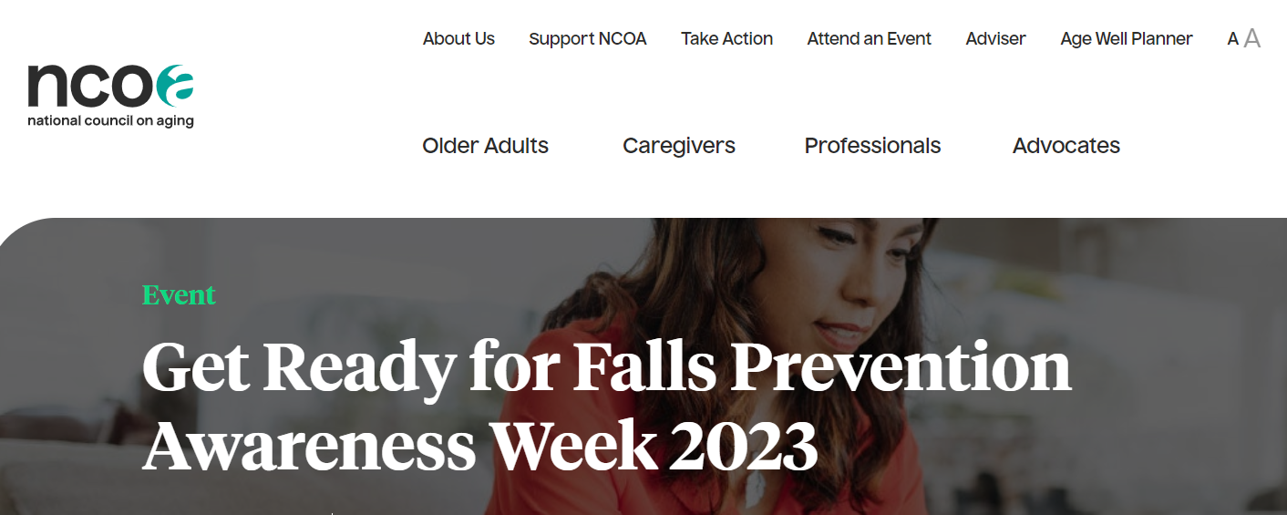
National Council on Aging Content
https://connect.ncoa.org/products/get-ready-for-falls-prevention-awareness-week-2023

Slide 11
Our 2023 Goals – let’s go for straight A’s
Getting into the community more frequently (awareness)
Moving forward the Store Safety Modification Program
Increasing the impact of Falls Prevention month & re(using) assets
Continue to develop our metrics
In order to….. collectively raise island-wide awareness of the risk of falling as one ages, to educate Older Adults on fall prevention strategies, and to empower Older Adults to take action to reduce their fall risk and, when they do fall, recover more quickly.

Slide 12
We have identified 4 work groups*
Falls Prevention Coalition 2023
Group 1: Education & Prevention | Group 2: Strengthening Healthcare connections | Group 3: Improving safety in our homes and communities | Group 4: Metrics of Success
Oversees falls prevention month and getting into the community more often: MOB and other programs | How well we are working with healthcare providers, awareness of our work/programs | Includes Home Safety Modification/Store Safety Modification, evaluating technology options | How do we determine success? What are the metrics we can use?
Members
Leslie Clapp, MVC4L | Lorna Andrade, NAACP Healthy Equity | Carolina Cooney, Chamber of Commerce | Ian Campbell, MVH
Rose Cogliano, Oak Bluffs COA | Cheryl Kram, CapeCod Health | Victoria Haeselbarth, Anchors | Alexis Babaian, IHC
Meris Keating, Anchors | Michele LeBlanc, MVCS CORE | Lori Perry, IHC | Marina Lent, BOH Aquinnah
Sue Merrill, UPICOA | Anna McCaffery, BOH Chilmark | Cindy Trish, HAMV
Joyce Stiles Tucker, Tisbury COA | Susan Sanford, VCM | Allyson Malik, OB library
Anne McDonough, Vineyard Haven library | Suzanne Robbins, MVH | Sue Silk, Consumer Activist
Lew Laskaris, MVH Retired | Kathleen Samaways, IHC | Catie Blake, BOH
Zonica Simpson, MVH
Abby Leighton, YMCA
*Note Groups 2 & 4 are combined

Slide 13
Current Falls Prevention Coalition Members*
Broad representation from island organizations but always room for more!
Lorna Andrade, drlorna.andrade@hotmail.com
Alexis Babaian, ababaian@ihimv.org
Catie Blake, cfuller@tisburyma.gov
Carolina Cooney, Carolina@mvy.com
Ian Campbell, ICAMPBELL4@partners.org
Leslie Clapp, lesliec@mvcenter4living.org
Rose Cogliano, rcogliano@oakbluffsma.gov
Cindy Doyle, cdoylema@me.com
Lila Fischer, lfischer@ihimv.org
Victoria Haeselbarth, vhaeselbarth@edgartown-ma.us
Cheryl Kram, ckram@capecodhealth.org
Meris Keating, mkeating@Edgartown-ma.us
Michele LeBlanc, mleblanc@mvcommunityservices.org
Lewis Laskaris, llaskaris@icloud.com
Abby Leighton, ALeighton@ymcamv.org
Marina Lent, boh@chilmarkma.gov
Allyson Malik, amalik@clamsnet.org
Anna McCaffery, boh@chilmarkma.gov
Anne McDonough, amcdonough@clamsnet.org
Susan Merrill, coa-outreach@westtisbury-ma.gov
Megan Panek, megan.panek@escci.org
Lori Perry, lperry@ihimv.org
Suzanne Robbins, SROBBINS5@partners.org
Kathleen Samways, ksamways@ihimv.org
Susan Sanford, susan@vcmpt.com
Sue Silk, susan.silk@comcast.net
Zonica Simpson, ZSIMPSON1@partners.org
Joyce Stiles-Tucker, jstucker@tisburyma.gov
Cindy Trish, ctrish@hamv.org
Lynn Marquedant, LynnMarquedant@hamv.org
*Updated 5/2023

