Slide 1
MV Falls Prevention Coalition 2021
Agenda:
Review Falls Prevention month activities/impact (what worked, what didn't, what we might want to consider doing differently next year)
How do we utilize these assets/energy going forward throughout the year?
Getting into the community more - what could our 2022 calendar look like?
A review of what's going on at the National Falls Prevention Coalition (as thought starters for our priorities/funding opportunities for 2022) and research roundup
Call to Action Digital Inequity for Older Adults -why we are doing this and how you can lean in
Nov 16
ctrish@hamv.org
508 693-7900 ext.455

Slide 2
Falls Prevention Month 2021
In previous discussions, we have identified 3 focus areas for Falls Prevention Month (and beyond)
Raising awareness on fall risk as you age
Education/Resources on reducing falls
Empowering Older Adults to take action
Our assets and activities were tied to this framework.

Slide 3
Our Coalition Assets
Fall Prevention Month Assets | Purpose | Distribution
Updated Falls Prevention Brochure (printed) | Awareness Education Empowerment | Available for all Coalition members to distribute
NCOA Myths One pager (printed) and other social media assets | Awareness Education | Reprinted copies from NCOA available for all Coalition members to distribute; content can be used for PSA’s, newsletter articles, websites etc.
Public Service Announcements-MVTV | Awareness Education Empowerment | Links will be available to PSAs
Home Safety Modification Brochure (printed) | Empowerment | Available for all Coalition members to distribute
Assessment of Fall risk checklist (printed) | Education Empowerment | Available for all Coalition members to distribute
Exercise cards to prevent falling | Education Empowerment | Available for all Coalition members to distribute
Pain-free Screening (VCM provided) | Education Empowerment | Available for all Coalition members to distribute
Zoom recording on what to do if you fall (getting up from a fall) | Education Empowerment | Information on these zoom sessions will be provided on a 1 pager for you to distribute
Zoom recording on balance assessment/prevent falls | Education Empowerment
MVY radio interview | Education Empowerment | Links will be available to show

Slide 4
Our September 2021 Calendar of Activities
Action/Event | When | How
Distribute printed material: Falls Prevention Brochure Home Safety Modification Falls Self-Assessment Exercise cards | Sept 7 -30 | COAs, MVH, VCM, Island Health Care, Vineyard Health Care Access, VNA, Meals on Wheels, Elder Services, Food Pantry, VNA, MVCS, C4L, YMCA, libraries, Opticians
PSAs on MVTV | All month | MVTV
10 Myths of Falling PSAs | All month | MVY Radio
Awareness/Educational Advertising Campaign | All month | MV Times/Gazette
Education/information sessions | Sept 20-24 (Falls Prevention Week) | Zoom sessions: What to do when you fall (Catie Blake/Tisbury COA) Balance exercises to prevent a fall (Natasha Snowden/YMCA Healthy Agers) Fall Prevention Exercises (VCM)
VCM Pain Free screening | Sept 22 (Falls Prevention Day) | Free 20 minute evaluation that is open to the public. Screenings can be conducted in their clinic, in their outside clinic room and by Tele-health. Visit https://vcmpt.com/upcoming-events/ or call 508-693-3800 to schedule your screening
55+ MV Times article | Sept 30 | Feature article in this section
Interview on MVY Radio | SUNDAY, OCTOBER 3rd at 7pm SUNDAY October 10th at 11pm | Nightcasts

Slide 5
Discussion
What felt like it worked?
What didn’t?
What might we want to do differently next year?
How do we utilize these assets going forward?
All assets are on the HAMV website https://www.hamv.org/falls-prevention
HAMV completed the NCOA survey on activities/impact

Slide 6
2022 Calendar of Events
Thinking about our 5 work groups/priority areas
Where do we want to be?
What do we want to share?
What assets do we need to develop?
Education/ Prevention | Strengthening Healthcare Connection | Improving Safety in our Homes and Communities | Digital Access | Metrics of Success

Slide 7
National Falls Prevention Update
Medications/Falls Prevention (Dr. Donna Bartlett)
Falls Prevention Conversation guide for Caregivers’ https://www.ncoa.org/article/falls-prevention-conversation-guide-for-caregivers?utm_source=newsletter&utm_medium=email&utm_campaign=CHA
Introduction of an Evidence based falls prevention program – reignite Matter of Balance?

Slide 8
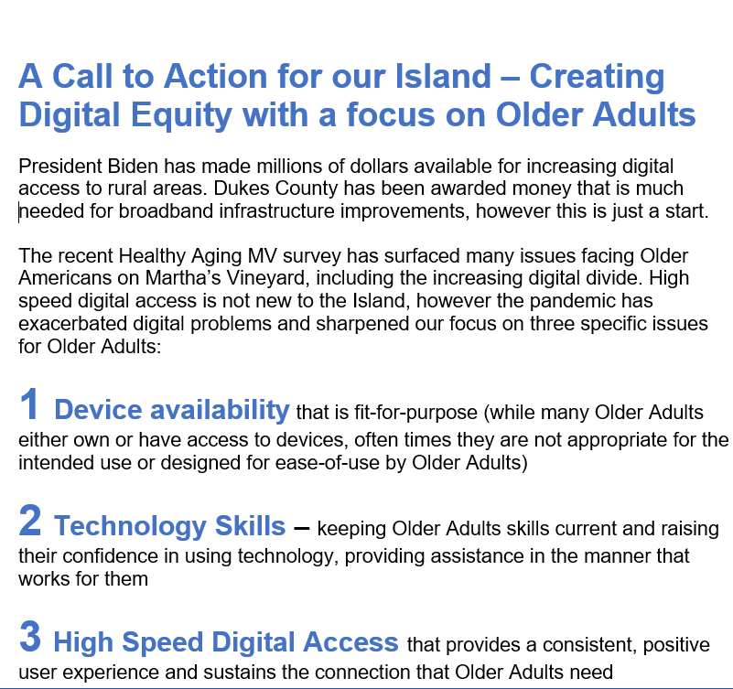
Update on Digital Equity Initiative
Our primary focus will be on technology training assistance for Older Adults, part of the “technology trinity”
We will support others efforts to reduce digital inequity by providing our support for specific actions taken locally and nationally
To that end, we are creating a list of individuals and organizations who we can reach out to when we have a specific need
We are asking you to return your call-to-action form signed

Slide 9
Which looks like this
How You Can Help
Join our email list so you can stay aware of our progress and specific call-to-action (you can do so by responding to this email)
Consider adding your organization or individual name to our list of supporters and providing your logo for appeals to local, state and federal officials (we will ask each time for your permission)
Join our task force as a volunteer to move this cause forward (you can do so by responding to this email)
Yes, count me in to support this initiative.
Name________________________________________
Organization__________________________________
______Yes, you may use our logo as a supporter with prior approval
______Yes, please keep me apprised of what you are doing and how I can help

Slide 10
Falls Prevention Coalition 2021 Objectives and Work Groups

Slide 11
We’ve identified our focus areas for 2021
Education/Prevention
Strengthening healthcare connection
Improving safety in homes and our communities
Digital access
Metrics of Success
….and the work groups as well!

Slide 12
Updated Focus Area Work Groups
Education/ Prevention | Strengthening Healthcare Connection | Improving Safety in our Homes and Communities | Digital Access | Metrics of Success
Lead: Tanya Larsen | Lead: Thaddeus Thompson | Lead: Megan Panek | Lead: Betty Robie | Lead: Ian Campbell
Joyce Stiles-Tucker | Cindy Doyle | Catie Blake | Lorna Andrade | Bob Laskowski
Suzanne Robbins | Lori Perry | Cheryl Kram | Anne McDonough | Kathleen Samways
Valci Carvalho | Marina Lent | Victoria Haeselbarth | Cindy Trish
Lila Fischer | Lisa Hollander | Michele LeBlanc
Rose Cogliano

Slide 13
Education/Prevention Focus Area
Community education
Identifying the right content (and do we want to update our current brochure?)
Defining the audience
Communications campaign - frequency of messaging
Delivery Methods (print, digital TV, radio)
Falls Prevention Month (Sept) - how do we want to participate?
Prevention
An audit -what prevention programs currently exist on the island?
Investigation of evidence-based programs (including Matter of Balance which has gone quiet)
Selection and implementation of a prevention programs (if identified as a need)

Slide 14
Strengthening Healthcare Connections Focus Area
Purpose: Leveraging the strengths and talents of all island organizations and increase the visibility of coalition
Map the connection points between different organizations for falls prevention/recovery (as an example, hospital care for a fall followed up by participation in a YMCA program)
Communicate and raise awareness of these connection points and coalition’s role
Use this knowledge to identify gaps and where the coalition can “lean in”

Slide 15
Improving Safety in our homes and communities focus area
Advocacy, Awareness and Facilitation
Advocate for those who have a need for falls prevention efforts
Create awareness for programs/information to increase safety
Facilitation – bringing together different organizations to provide an integrated approach to improving safety (look for overlap with Disabilities Coalition)
Identify programs for the home – e.g. home audits
Look for “low hanging” fruit in the community

Slide 16
Digital Access Focus Area
Dedicated to improving safe, accessible, affordable digital access to Fall Prevention training, information, resources for older adults
Identify hardware and software needs and local resources available
Create local, (e.g. Disabilities Coalition and schools), state and national partnerships sharing this vision
Explore funding sources/implementation

Slide 17
Metrics of Success Focus Area
Create an annual message/story to demonstrate effectiveness
Stories (qualitative) of impact of falls prevention on community members
1-2 standard metric (quantitative) tracked at the state level (TBD)
Economic savings from falls prevention (TBD)
Multiple modes of delivery (video, press releases, newspaper articles)
Identified Sources of information – a starting list
Screening data from the hospital (collected during wellness visits, falling history/likelihood of falling)
Home Safety Modification Program pre/post survey data
Older Adult 2020 Survey data, EMS data, what else?

Slide 18
Current Falls Prevention Coalition Members*
Broad representation from island organizations but always room for more!
Lorna Andrade, drlorna.andrade@hotmail.com
Catie Blake, cfuller@tisburyma.gov
Ian Campbell, ICAMPBELL4@partners.org
Valci Carvalho, vcarvalho@partners.org
Leslie Clapp, lesliec@mvcenter4living.org
Rose Cogliano, rcogliano@oakbluffsma.gov
Cindy Doyle, cdoylema@me.com
Lila Fischer, lfischer@ihimv.org
Victoria Haeselbarth, vhaeselbarth@edgartown-ma.us
Lisa Hollander, lisahollander@comcast.net
Cheryl Kram, ckram@capecodhealth.org
Tanya Larsen, coa-staff@westtisbury-ma.gov
Bob Laskowski, laskowskiadvisors@gmail.com
Michele LeBlanc, mleblanc@mvcommunityservices.org
Marina Lent, boh@chilmarkma.gov
Anne McDonough, amcdonough@clamsnet.org
Megan Panek, megan.panek@escci.org
Lori Perry, lperry@ihimv.org
Betty Robie, brobie@ymcamv.org
Suzanne Robbins, SROBBINS5@partners.org
Kathleen Samways, ksamways@ihimv.org
Susan Sanford, susan@vcmpt.com
Joyce Stiles-Tucker, jstucker@tisburyma.gov
Thaddeus Thompson, tthompson3@partners.org
Cindy Trish, ctrish@hamv.org
*Updated 11/2021

