Slide 1
WELCOME TO THE COMMUNITY SUMMIT
ON AGING
1

Slide 2



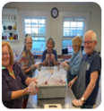

TODAY’S AGENDA
GO BACK UPSTAIRS
SESSION 1
SESSION 3
Lunch from Black Sheep
YOUR AGING JOURNEY AND HOW TO HAVE FUN WITH IT
Nancy Aronie, Founder Chilmark Writing Workshop, Author of Memoir as Medicine
Music by the Ukeladies
AGING TRENDS ON MV FOR THE NEXT 10 YEARS
Adam Turner, MV Commission
Cindy Trish, HAMV
Let’s take a look at the data
12:00 – 1:30
1st Floor
3:30 – 4:30
2nd Floor
GO UPSTAIRS
GO DOWNSTAIRS
6 KEY PRIORITIES FOR AN
AGE-FRIENDLY ISLAND
Denise Schepici, MV Hospital President
Lyndsay Famariss, Edgartown COA, HAMV Board
Bob Laskowski, Physician, Former HC CEO, HAMV Board
Nancy Tutko, Project Manager TrailsMV
Alexandria Pratt, Director WT Library
Iris Freeman, Educator in Elder Justice, HAMV Board
Kate Lefer, MV Community Services, DEI
Cindy Trish, HAMV Executive Director
POLICIES THAT COULD IMPACT AGING ON MV AND WHAT WE CAN DO
Michael E. Festa, State Director, AARP Massachusetts
Network while enjoying light snacks and beverages; Sign-up for action committees
SESSION 2
SESSION 4
1:45 – 3:00
2nd Floor
4:45 – 5:30 *
1st Floor
* WE’LL FINISH IN TIME FOR WT RESIDENTS TO ATTEND SPECIAL TOWN MEETING
GO DOWNSTAIRS FOR HAMV BIRTHDAY CAKE
2

Slide 3
What is your number 1 concern about aging on Martha's Vineyard?
3

Slide 4
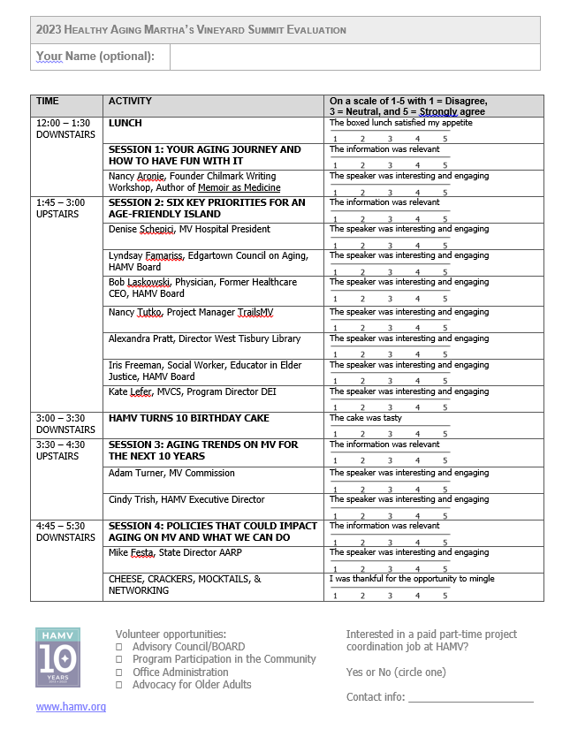
Give us your feedback
Please leave your evaluation forms in the box at the table before you leave
4

Slide 5
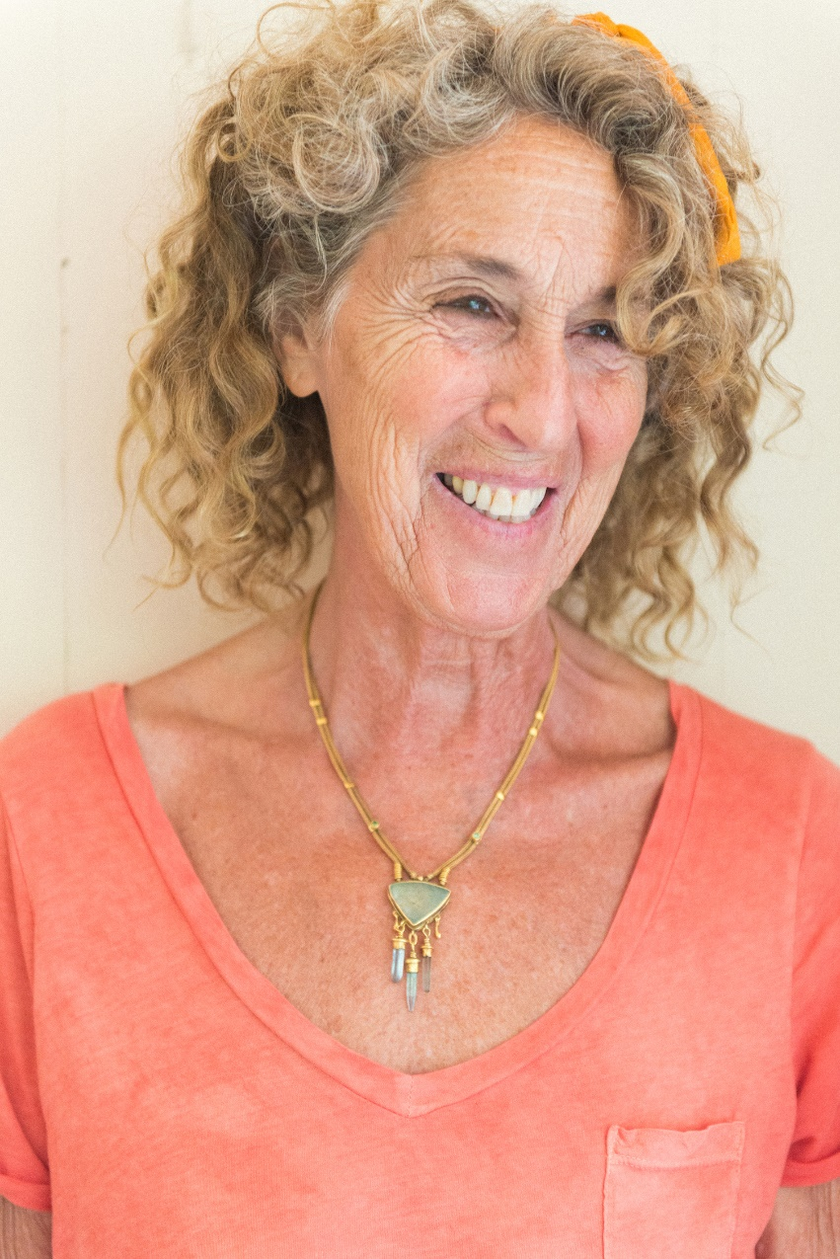

SESSION 1
Lunch from Black Sheep
YOUR AGING JOURNEY AND HOW TO HAVE FUN WITH IT
Nancy Aronie, Founder Chilmark Writing Workshop, Author of Memoir as Medicine
Music by the Ukeladies
12:00 – 1:30
1st Floor
5

Slide 6
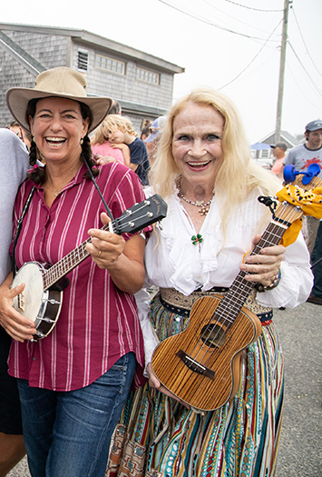
Thank you to the Ukeladies!
6

Slide 7
SESSION 2 is UPSTAIRS
GO BACK UPSTAIRS
SESSION 1
SESSION 3
Lunch from Black Sheep
YOUR AGING JOURNEY AND HOW TO HAVE FUN WITH IT
Nancy Aronie, Founder Chilmark Writing Workshop, Author of Memoir as Medicine
Music by the Ukeladies
AGING TRENDS ON MV FOR THE NEXT 10 YEARS
Adam Turner, MV Commission
Cindy Trish, HAMV
Let’s take a look at the data
12:00 – 1:30
1st Floor
3:30 – 4:30
2nd Floor
GO UPSTAIRS
GO DOWNSTAIRS
6 KEY PRIORITIES FOR AN
AGE-FRIENDLY ISLAND
Denise Schepici, MV Hospital President
Lyndsay Famariss, Edgartown COA, HAMV Board
Bob Laskowski, Physician, Former HC CEO, HAMV Board
Nancy Tutko, Project Manager TrailsMV
Alexandria Pratt, Director WT Library
Iris Freeman, Educator in Elder Justice, HAMV Board
Kate Lefer, MV Community Services, DEI
Cindy Trish, HAMV Executive Director
POLICIES THAT COULD IMPACT AGING ON MV AND WHAT WE CAN DO
Michael E. Festa, State Director, AARP Massachusetts
Network while enjoying light snacks and beverages; Sign-up for action committees
SESSION 2
SESSION 4
1:45 – 3:00
2nd Floor
4:45 – 5:30 *
1st Floor
* WE’LL FINISH IN TIME FOR WT RESIDENTS TO ATTEND SPECIAL TOWN MEETING
GO DOWNSTAIRS FOR HAMV BIRTHDAY CAKE
7

Slide 8
SESSION 3 Will Start Soon
GO BACK UPSTAIRS
SESSION 1
SESSION 3
Lunch from Black Sheep
YOUR AGING JOURNEY AND HOW TO HAVE FUN WITH IT
Nancy Aronie, Founder Chilmark Writing Workshop, Author of Memoir as Medicine
Music by the Ukeladies
AGING TRENDS ON MV FOR THE NEXT 10 YEARS
Adam Turner, MV Commission
Cindy Trish, HAMV
Let’s take a look at the data
12:00 – 1:30
1st Floor
3:30 – 4:30
2nd Floor
GO UPSTAIRS
GO DOWNSTAIRS
6 KEY PRIORITIES FOR AN
AGE-FRIENDLY ISLAND
Denise Schepici, MV Hospital President
Lyndsay Famariss, Edgartown COA, HAMV Board
Bob Laskowski, Physician, Former HC CEO, HAMV Board
Nancy Tutko, Project Manager TrailsMV
Alexandria Pratt, Director WT Library
Iris Freeman, Educator in Elder Justice, HAMV Board
Kate Lefer, MV Community Services, DEI
Cindy Trish, HAMV Executive Director
POLICIES THAT COULD IMPACT AGING ON MV AND WHAT WE CAN DO
Michael E. Festa, State Director, AARP Massachusetts
Network while enjoying light snacks and beverages; Sign-up for action committees
SESSION 2
SESSION 4
1:45 – 3:00
2nd Floor
4:45 – 5:30 *
1st Floor
* WE’LL FINISH IN TIME FOR WT RESIDENTS TO ATTEND SPECIAL TOWN MEETING
GO DOWNSTAIRS FOR HAMV BIRTHDAY CAKE
8

Slide 9
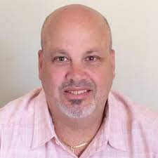
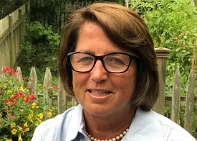

The Next Ten Years
Aging Challenges and Opportunities on Martha’s Vineyard
Adam Turner
Executive Director, MVC
Cindy Trish
Executive Director, HAMV
9

Slide 10
What we will cover today
Where are we today?
How will the Island change over the next 10 years?
What priorities/decisions are we addressing for the future?
How will these changes impact Older Adults?
What do we need to do differently to meet the needs of this growing population?
How you can make a difference
10

Slide 11
A primer – Where Are We Today?
Current Demographics
11

Slide 12
Population by Town, 1930-2020
US Census Decennial Counts
12

Slide 13
Age Distribution (% of Population): County, State, Nation, 2021
American Community Survey 5-Year Estimates
Dukes County has about 33% more people over 60, compared to the state. The biggest differences are in people 70-74 (about 48% more), and people 85 and up (about 37% more).
Age Group | County | State | Nation | County-State % Difference
60-64 | 8.9% | 6.6% | 6.3% | 29.2%
65-69 | 7.1% | 5.5% | 5.3% | 22.5%
70-74 | 8.1% | 4.3% | 4.2% | 48.1%
75-79 | 4% | 2.7% | 2.7% | 32.5%
80-84 | 1.8% | 1.8% | 1.8% | 0%
85+ | 3% | 2.3% | 1.9% | 36.7%
Total (60+) | 32.9% | 23.2% | 22.2% | 32.5%
13

Slide 14
Age Distribution by Town (% of Population), 2021
American Community Survey 5-Year Estimates
14

Slide 15
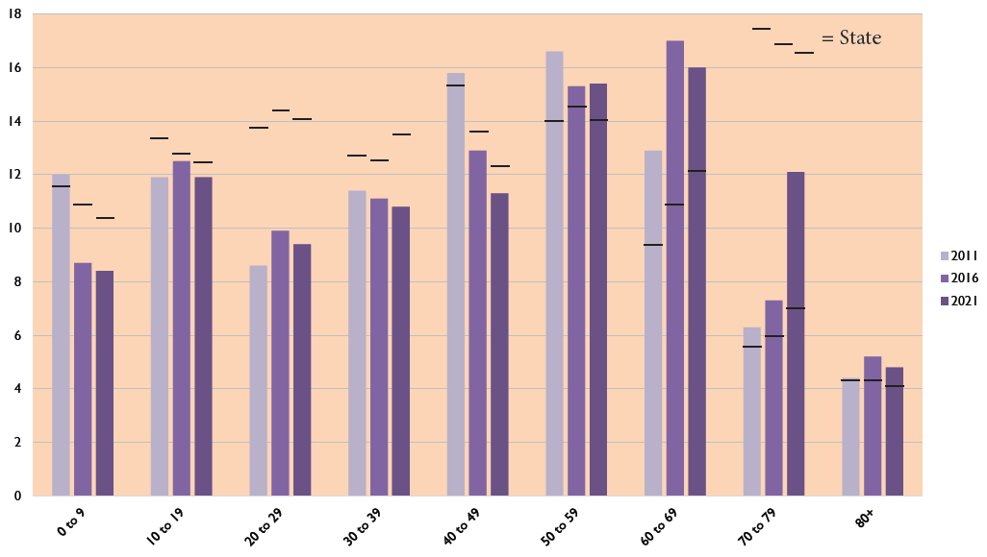
Population by Age Group (% of Total), 2011-2021
American Community Survey 5-Year Estimates
The percentage of residents 60 and up has increased faster in Dukes County than statewide since 2011.
Also note overall differences in age distribution compared to the state.
15

Slide 16
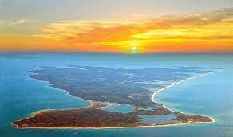
Older Islanders experience unique challenges that impact access to health care and create social isolation
  Income levels are below state average while the cost of living exceeds state average.
  Older Adults must go off-island to receive specialist care with over 8,000 trips to Boston alone forecasted for 2024.
  20% of 85+ do not have a dentist, 35% of those that do go off island to seek dental care*.
  The rural nature of the island creates transportation challenges with fixed routes often too far away to be accessible by Older Adults and other options are often cost prohibitive.
MV is considered a medically underserved region (MUA/P)
Our ratio of dentists/population ranks in the lowest tier for the state*
Dukes County ranks 2nd highest in % of Older Adults to the total population*
*Source - County Health Rankings and Road Maps
*(Dec 2020 HAMV Older Adult Island-wide Survey; 2,480 respondents)
l
16

Slide 17
80+ Older Adults are most likely to have lower incomes and inadequate financial resources to meet daily needs
Income distribution is relatively consistent across all age groups except for ≤$50K.
1 in 2 85+ HHs fall within the ≤$50K income category.
3% overall report they do not have the financial resources to meet their daily needs; increases to 21% of those with incomes <$25K.
Questions 67, 68 (Dec 2020 HAMV Survey)
17

Slide 18
The accelerated past growth of the Older Adult population has caught up with us in a culture of “age-in-place”
Infrastructure Challenges
Downsizing options limited
Strained Services
Extensive waiting lists for income-based in-home services
Limited private pay options requiring off-island workforce
5+ year waiting lists for Elderly Housing
Lack of workforce housing
Lack of Assisted Living Options
10+ year journey for a skilled nursing facility still underway
Lack of integrated care program options (i.e. Medicare Advantage/PACE programs etc.)
“Thin” health, dental and behavioral health resources
18

Slide 19
Understanding Our Service Landscape
MVC Older Adult Services Database (2019)
19

Slide 20
MVC Older Adult Service Mapping Project (2019)
Point-in-time directory of older adult service providers, including annual budgets and searchable online database.
Analysis of demographics, older adult needs, participation rates, funding sources, budgets, gaps in service, etc.
Identification and analysis of major service categories.
Intended to help Island towns and organizations document their annual spending and better serve the older adult community.
Foundation for continued analysis of service availability, funding, and budgets.
20

Slide 21
MVC Older Adult Service Database (2019)
MVC surveyed Island organizations to evaluate the availability of existing services, identify key challenges and opportunities, and gauge the availability of data related to participation rates, budgets, and funding sources.
Identified 43 organizations that provide older adult services to Island residents, and 23 service categories.
Program directors emphasized concerns related to housing, social isolation, workforce availability, financial resources and the seasonal economy, as well as the benefit of dispersed, sometimes redundant services across the Island.
21

Slide 22
Service Categories Ranked by Number of Providers (2019)
Volunteer opportunities 21
Education 20
General info and referral 19
Home-based services 17
Medical health services 16
Recreation and socializing
(non-medical, and not including meals) 16
Support programs (group or individual) 13
Meals and nutrition 12
Fitness 11
Transportation
(not including direct ambulance services) 11
Admin. assistance and applications (health) 10
Admin. Assistance (non-medical) 10
Advance care planning 10
Food, fuel, and utilities assistance 10
Housing, shelter, housing assistance 10
Disability services 7
Elder abuse and domestic violence 7
Technological support (not including libraries) 7
Behavioral health:
mental health counseling and services 6
Palliative and hospice care 5
Emergency medical services 4
Transportation (ambulance) 4
Veterans services 4
Financial support 3
Nursing and long-term care 3
Behavioral health:
substance use disorder services 2
Employment services 2
Holistic therapy 2
22

Slide 23
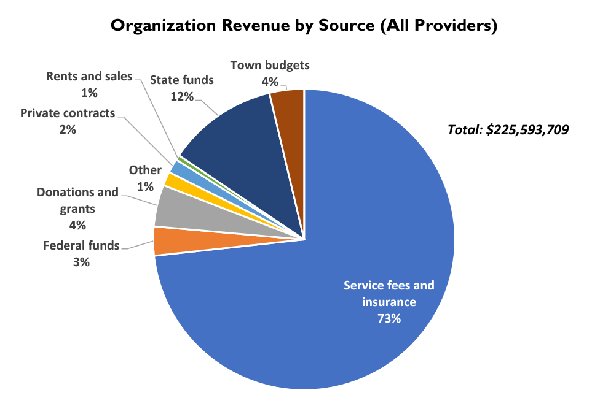
Selected findings
23

Slide 24
Summarizing our Current Service Landscape
Service landscape does not adequately address the current need
Lack of available workforce is a major limitation in addressing the need, both year round and seasonally
There is overlap in the number of organizations offering the services in the same category
Lack of a vision of integration for a “continuum of care” across the service landscape
Multiple sources of funding, with town funding represents a small slice of the total social services revenue pie
24

Slide 25
The Next 10 Years
Population Projections
What Will the Island Demographics Look Like and What are the Implications for Older Adults?
25

Slide 26
Population Projections by Town, 2020-2030
UMass Donahue Institute, 2022
2.3% increase
26

Slide 27
Population Projections by Town, 2020-2030
 | 2020 | 2025 | 2030
Aquinnah | 311 | 438 | 433
Chilmark | 866 | 1,213 | 1,133
Edgartown | 4,067 | 5,166 | 5,084
Gosnold | 75 | 70 | 59
Oak Bluffs | 4,527 | 5,339 | 5,724
Tisbury | 3,949 | 4,816 | 4,955
W. Tisbury | 2,740 | 3,554 | 3,589
County | 20,596 | 20,977 | 21,072
UMass Donahue Institute, 2022
The county population is expected to increase about 2.3% by 2030. This is mostly due to projected growth in the 75+ age range, while ages 15-29 and 45-74 are expected to decline.
27

Slide 28
Population Projections by Age (County), 2020-2030
UMass Donahue Institute, 2022
Age % Change
0-14: 4.6% increase
15-29: 9.5% decrease
30-44: 1.4% increase
45-59: 18.6% decrease
60-74: 2.2% decrease
75+: 77.7% increase
Total: 2.3% increase
28

Slide 29
Population Projections by Older Age Group, 2020-2030
UMass Donahue Institute, 2022
Among residents 60+, the older groups (75+) are projected to increase more than the younger groups, and people 60-64 are projected to decline. This is largely a result of the aging Baby Boomer generation (born ~1946 and 1964).
29

Slide 30
Population Projections (All Groups 60+),
2020-2030
UMass Donahue Institute, 2022
As a whole, people over 60 currently make up about 34% of the Island population. This is projected to increase to about 40% in 2030.
30

Slide 31
And Beyond Population Changes….the Island will be dealing with other growth related issues
The ongoing tension around maintaining the rural nature of our Island
Planning for climate change impact
Emergency planning coordinated management
Addressing supply/demand inequities (residents and visitors)
Ensuring access to medical, dental, and mental health care
31

Slide 32
What do these population changes mean for Older Adults?
There is an accelerated need to address the growing demand for in-home services at all stages of the aging journey but especially for 85+ age group
Immediate expansion of infrastructure options to address when age-in-place becomes inadequate, either for short or long term situations
We need a dynamic service design to effectively address the population peak of 85+ and eventual redistribution of ages of Older Adults
32

Slide 33
Where Do We Go From Here?
It Starts with Thinking Differently and Acting Differently
Collaboration – Mobilization - Action
33

Slide 34
It Starts with Leveraging and Expanding our Foundational Assets
Stable Hospital and Expanding Medical Services
Extensive Older Adult Volunteer Base
An Island Community Culture of Caring
Long Term Planning Capabilities
Broad Range of Services and Programs
34

Slide 35
HAMV’s Current Program Offerings
Home Safety Modification Program
GoGoGrandparent
Affordable Connectivity Program
Computer Repair
Home Sharing
Advance Care Planning
Matter of Balance
Project Happiness
35

Slide 36
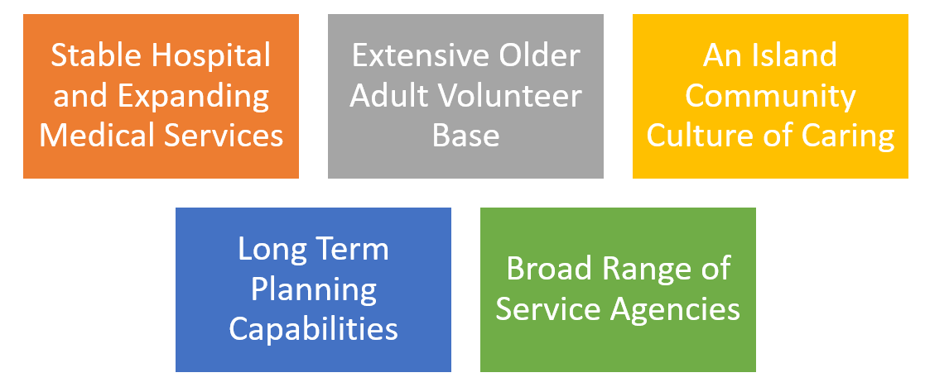
And We will Utilize these Assets to Focus on 3 Areas
Planning
Services
Infrastructure
36

Slide 37
Where We Want To Go – Planning
The End Game:
An integrated Island-wide multi-year Strategic Plan that encompasses the service network and infrastructure requirements for all stages of our aging journeys, with a focus on 85+ age group and a road map to get there.
HOW DO WE GET THERE?
37

Slide 38
How Do We Get There – Recommendations for Planning
Initiate an intensive community planning process involving service providers and the public
Increase involvement of Island housing advocates in older adult service planning
Expand involvement among groups that may not consider themselves providers of older adult services (libraries, public safety departments, etc.)
38

Slide 39
Where We Want To Go – Service Landscape
The End Game:
Increase Service Capacity Faster than we do today
Improve return on investment
Eliminate service overlaps
Identify and fill service gaps
– aligned to the needs of our changing Older Adult population
HOW DO WE GET THERE?
39

Slide 40
How do we get there – Recommendations for Service Landscape
Evaluate existing Older Adult services, in terms of effectiveness and opportunities for improvement
Increase town oversight of data collection, including possible requirements/incentives for annual data reporting by service providers
Develop a “continuum of care” framework for the Island service agencies that aligns to the aging journey supporting an aging (and dying) -in-place model
Implement a shared service model where it makes sense
40

Slide 41
Where We Want To Go – Infrastructure
The End Game:
Keeping Older Adults on-Island
HOW DO WE GET THERE?
41

Slide 42
How Do We Get There – Recommendations for Infrastructure
Modify Older Adult homes to age-in-place safely
Provide on-island independent living downsizing options
Complete construction on The Navigator (skilled nursing facility)
Create an on-island assisted living option
Establish a central Aging Adult Center for a one-stop-shop for services
42

Slide 43
Looking to the Future - New Programs On Deck at HAMV….
Store Safety Modification Program
Off Island Medical Transportation
Call the Tech Pro
Volunteer Bank
Help on the Go
First Start
Integrated Transportation Scheduling
Beach Within Reach
43

Slide 44
A Pathway to Affording All We Want (and Need) to Do - Recommendations
Doing for ourselves
  Leveraging our Older Adults appetite for volunteering/digging in
Broadening our seed funding sources for pilot programs
  Test and learn process to minimize initial investment
Redeploy existing investment with shared service model
Increasing town/county commitment to Older Adult Social Services
Expanding state and federal funding
Seek private and business donations
44

Slide 45
A Pathway to Creating the Necessary Workforce -Recommendations
Resource sharing between agencies
Rotation program from state and federal programs
Integrated Career Development Program across agencies
Time Banking (volunteer)
Island-wide Recognition of Service (financial compensation)
Back-to-work/2nd career program
45

Slide 46
So in Closing, a Recap
What are the needs of Older Adults?
More transportation options
Improved dental and vision care
What is happening on our Island?
1 in 3 today are 60+
More will need more (as our population ages), especially for 85+
How do we address these needs?
We need to think and act differently.
More service capacity and options
Improved healthcare –both service providers and technical support
The fastest growing component for the next 10 years is 55+
Services offered are broad but with little depth
46

Slide 47
A Big Idea – A Call for a Central Island-wide Older Service Facility
A go-to physical destination where Older Adults can access all of the resources the island has to offer –
  Access to the breadth of service agencies
  Schedule and dispatch transportation wherever an Older Adult wants to go
  Access to information – medical financing, fuel assistance, tax support, etc.
  Providing dental/vision/ services
Service Agencies
Information Center
Access to dental and vision services
TransportCenter
Volunteer Center
47

Slide 48
And the Benefits are Vast
For Older Adults
Improved access to agencies
Increased awareness and usage of support services
For Agencies
Fosters a holistic approach toward client management across agencies (easier to communicate and collaborate)
Promotes resource and information sharing
For Our Island
Economies of scale across agencies
Improved utilization of existing services
Removes barriers to transportation
Convenient and less confusing
Accelerates the ability to add or realign services
Utilizes Older Adult volunteer contribution more effectively
48

Slide 49
How You Can Make a Difference
Advocate for Older Adult Causes
Ensure that the needs and perspectives of Older Adults are included in community discussions on priorities, funding etc.
Educate our Island to the contribution Older Adult’s make
Vote at Town Meetings
Share your expertise, experience and energy with Island organizations
Sign up today to support HAMV
Visit MVNPC website for volunteer opportunities
Make your Voices Heard
Donate
Volunteer
Be a Change Agent
Dispel aging stereotypes by your thoughts, words, and actions
Stay curious and flexible
Contribute financially to Island programs that serve Older Adults
Donate items you don’t need to appropriate agencies
49

Slide 50
SESSION 4 is Downstairs
GO BACK UPSTAIRS
SESSION 1
SESSION 3
Lunch from Black Sheep
YOUR AGING JOURNEY AND HOW TO HAVE FUN WITH IT
Nancy Aronie, Founder Chilmark Writing Workshop, Author of Memoir as Medicine
Music by the Ukeladies
AGING TRENDS ON MV FOR THE NEXT 10 YEARS
Adam Turner, MV Commission
Cindy Trish, HAMV
Let’s take a look at the data
12:00 – 1:30
1st Floor
3:30 – 4:30
2nd Floor
GO UPSTAIRS
GO DOWNSTAIRS
6 KEY PRIORITIES FOR AN
AGE-FRIENDLY ISLAND
Denise Schepici, MV Hospital President
Lyndsay Famariss, Edgartown COA, HAMV Board
Bob Laskowski, Physician, Former HC CEO, HAMV Board
Nancy Tutko, Project Manager TrailsMV
Alexandria Pratt, Director WT Library
Iris Freeman, Educator in Elder Justice, HAMV Board
Kate Lefer, MV Community Services, DEI
Cindy Trish, HAMV Executive Director
POLICIES THAT COULD IMPACT AGING ON MV AND WHAT WE CAN DO
Michael E. Festa, State Director, AARP Massachusetts
Network while enjoying light snacks and beverages; Sign-up for action committees
SESSION 2
SESSION 4
1:45 – 3:00
2nd Floor
4:45 – 5:30 *
1st Floor
* WE’LL FINISH IN TIME FOR WT RESIDENTS TO ATTEND SPECIAL TOWN MEETING
GO DOWNSTAIRS FOR HAMV BIRTHDAY CAKE
50

Slide 51
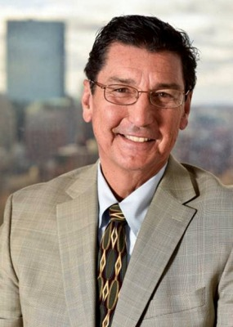

SESSION 4: POLICIES THAT COULD IMPACT AGING ON MV AND WHAT WE CAN DO
Michael E. Festa, State Director, AARP Massachusetts
51

Slide 52
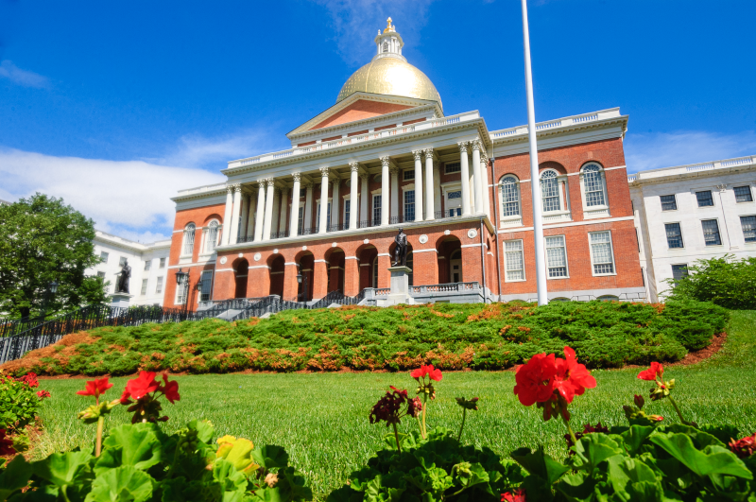
Contribute to Policy Changes: Stay Informed
Stay Updated about High Priority Advocacy Events:
Join us on www.mobilize.us/aarpma
You will join AARP's online network and will receive urgent news and action alerts about the issues that matter the most to older Americans, as well as information about AARP activities and events.
To stay up to date with Advocacy information and alerts text “Join” to 22777 to join AARP Advocacy Text alert program
Share your story. AARP is collecting and sharing stories with lawmakers to ensure they don’t ignore our needs. We’ll read each and every one, and use them to remind our elected leaders that their constituents need help NOW. Share your story www.aarp.org/iheartcaregivers
52

Slide 53


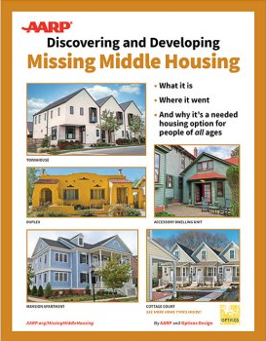
Contribute to Policy Changes: Housing
Free Housing Publications from AARP – www.aarp.org/livablelibrary
The ABCs of ADUs
Accessory Dwelling Units: A Step-by-Step Guide to Design and Development
Expanding ADU Development: Solutions for Removing Local Barriers to ADU Construction
Accessory Dwelling Units: Model State Act and Local Ordinance
Discovering and Developing Missing Middle Housing
Re-Legalizing Middle Housing: Model State Act and Local Ordinance
53

Slide 54



Supporting our Family Caregivers
Free Caregiving Publications from AARP – www.aarp.org/caregivingma
Family Caregiver Resource Guide: Massachusetts
Prepare to Care: A Planning Guide for Caregivers
Financial Workbook for Family Caregivers
Educational Caregiving Webinars
54

Slide 55

Stay Connected:
E-mail: aarpma@aarp.org
Phone: 886-448-3621
Web: aarp.org/ma
For support with your Age and Dementia Friendly activities and ideas reach out to Antron Watson, awatson@aarp.org
55

Slide 56
Thank you to our Speakers, Black Sheep, Ukeladies, The Grange, Andy Herr Music, MV Film Festival, Katryn Gilbert, and many more!
SESSION 1
SESSION 3
Lunch from Black Sheep
YOUR AGING JOURNEY AND HOW TO HAVE FUN WITH IT
Nancy Aronie, Founder Chilmark Writing Workshop, Author of Memoir as Medicine
Music by the Ukeladies
AGING TRENDS ON MV FOR THE NEXT 10 YEARS
Adam Turner, MV Commission
Cindy Trish, HAMV
Let’s take a look at the data
12:00 – 1:30
1st Floor
3:30 – 4:30
2nd Floor
6 KEY PRIORITIES FOR AN
AGE-FRIENDLY ISLAND
Denise Schepici, MV Hospital President
Lyndsay Famariss, Edgartown COA, HAMV Board
Bob Laskowski, Physician, Former HC CEO, HAMV Board
Nancy Tutko, Project Manager TrailsMV
Alexandria Pratt, Director WT Library
Iris Freeman, Educator in Elder Justice, HAMV Board
Kate Lefer, MV Community Services, DEI
Cindy Trish, HAMV Executive Director
POLICIES THAT COULD IMPACT AGING ON MV AND WHAT WE CAN DO
Michael E. Festa, State Director, AARP Massachusetts
Network while enjoying light snacks and beverages; Sign-up for action committees
SESSION 2
SESSION 4
1:45 – 3:00
2nd Floor
4:45 – 5:30 *
1st Floor
* WE’LL FINISH IN TIME FOR WT RESIDENTS TO ATTEND SPECIAL TOWN MEETING
56

Slide 57
Give us your feedback
Please leave your evaluation forms in the box at the table before you leave
Thank you for coming!
57

