Slide 1
MV Falls Prevention Coalition 2021
Agenda:
1-Review proposed activities for Falls Prevention month
2-What is missing?
3-What other communities are doing
4-Update on Home Safety Modification Program and proposal for Store Safety Modification Program
5-Update on Digital Equity efforts and our role
6-Anything else on your mind
August 17 meeting
ctrish@hamv.org
508 693-7900 ext.455

Slide 2
Getting Our Conversation Started
Key Dates to Keep in Mind
Falls Prevention Month (all of September)
Falls Prevention Week Sept 20-24
Falls Prevention Day (first day of Fall) – September 22
Additional sources of Information/content for us
CDC – https://www.cdc.gov/falls/facts.html ;
NCOA – Falls Prevention Program https://www.ncoa.org/article/falls-prevention-awareness-week-toolkit
Potential audiences we want to connect with during September and beyond
Older Adults
Caregivers
Professionals

Slide 3
Falls Prevention Month 2021
In previous discussions, we have identified 3 focus areas for Falls Prevention Month (and beyond)
Raising awareness on fall risk as you age
Education/Resources on reducing falls
Empowering Older Adults to take action
What do you/your organization currently have planned for Falls Prevention Month?

Slide 4
Thought Starters for Raising Awareness
Raising awareness on fall risk as you age
Sharing out statistics on falls (CDC Source)
10 myths of falling (Fact sheets provided by NCOA) https://www.cdc.gov/falls/facts.html
What information do we want to share?
What are our audience priorities (Older Adults, Caregivers, Providers)?
Timing for this campaign?
Distribution sources?

Slide 5
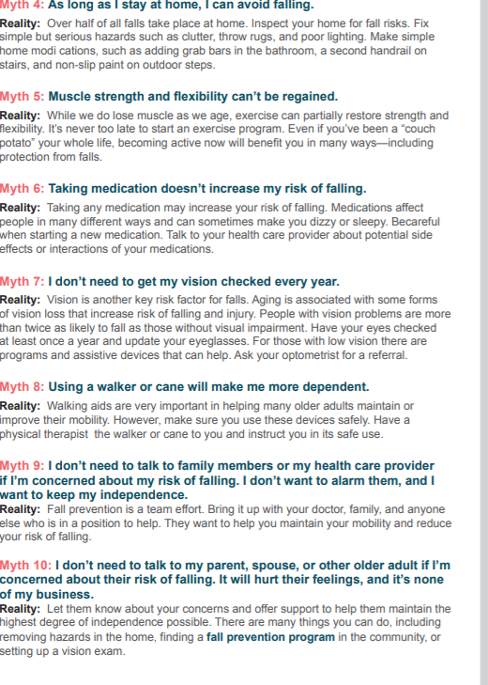
NCOA Myths Brochure

Slide 6
CDC Fall Information
Could we add in our survey data on falls on the island?
Other data sources you prefer?

Slide 7
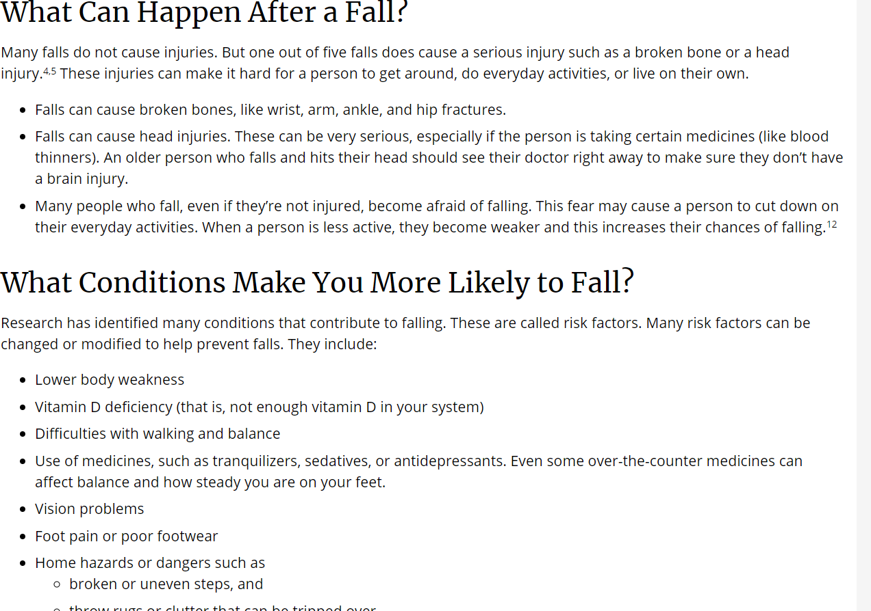
Additional CDC Fall Data
Should this information or type of information be part of our awareness campaign?
What would be the best way to present this?

Slide 8
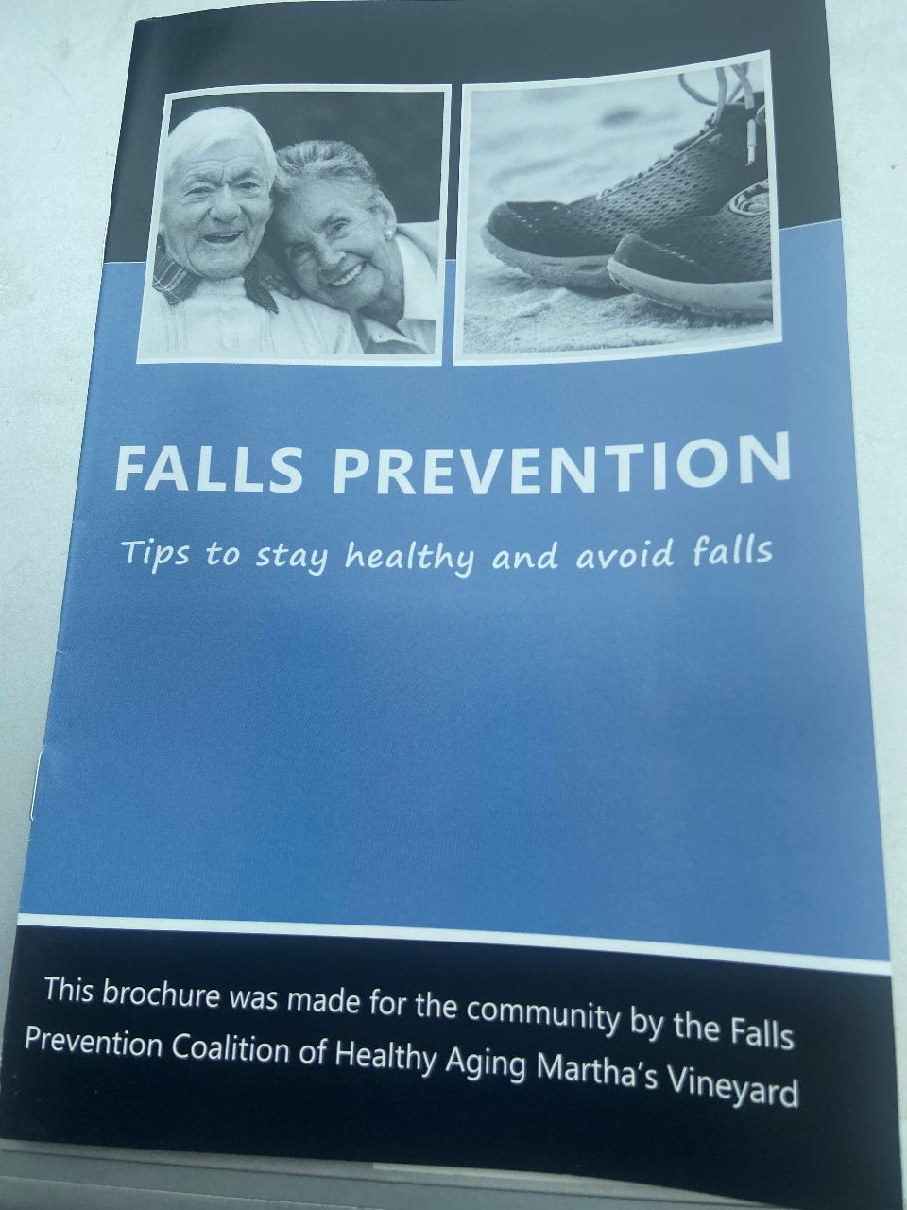
Education on reducing falls
Update our existing Falls Prevention Brochure developed by the coalition
Review and update contact information
Add in information on Home Safety Modification Program
Update the look/feel
Include logos of all Coalition members on the brochure
Print and distribute (timing, budget)
Brochure sections:
Did you know? (data on falls)
You can prevent falls
Have your vision checked
Exercise regularly
Make your home safer
Talk to your doctor
Important numbers

Slide 9
Examples of other brochures to review

Slide 10
Thought starters for Empowering Older Adults to Take Action
Under consideration:
Home Safety Assessment & Client Assessment tools (Safety in our homes/communities workgroup)
Falls Self Assessment created by the Greater Los Angeles Veterans Administration Geriatric Research Education Clinical Center
Healthy Agers Y- planning a balance assessment workshop/ How to Fall Workshop with Natasha Snowden on Sept. 22
Home Safety Modification Program (sharing out the brochures, sharing the PSA and raising awareness of this program)
Possibly leveraging The Still Going Strong Campaign from the CDC (they have brochures, posters, radio spots and social media content available we could use)

Slide 11
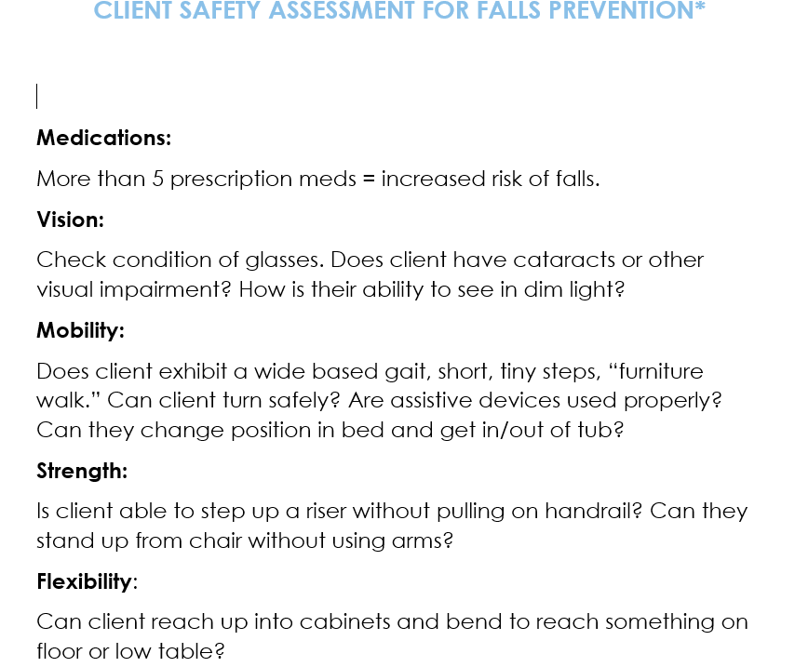
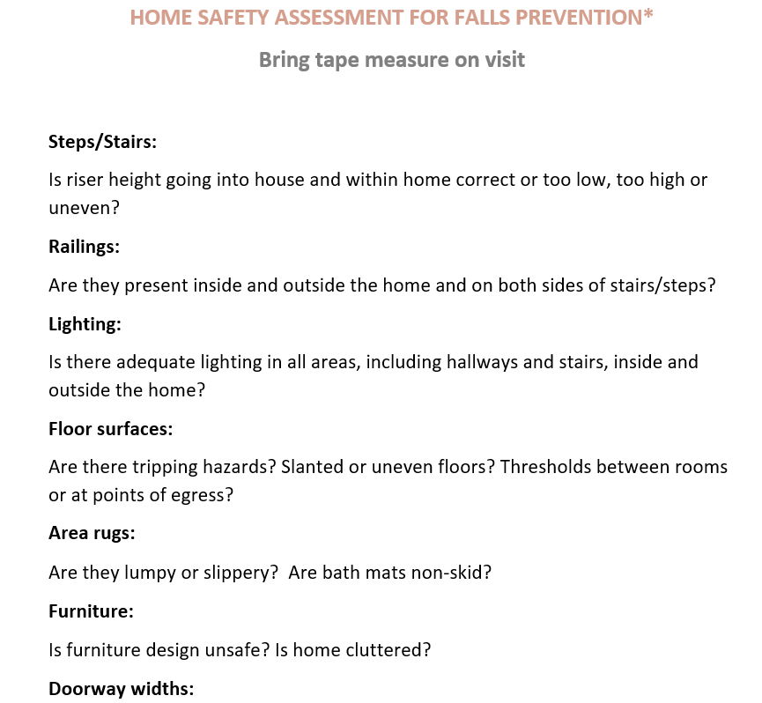
Examples of Home and Client Assessment tools

Slide 12
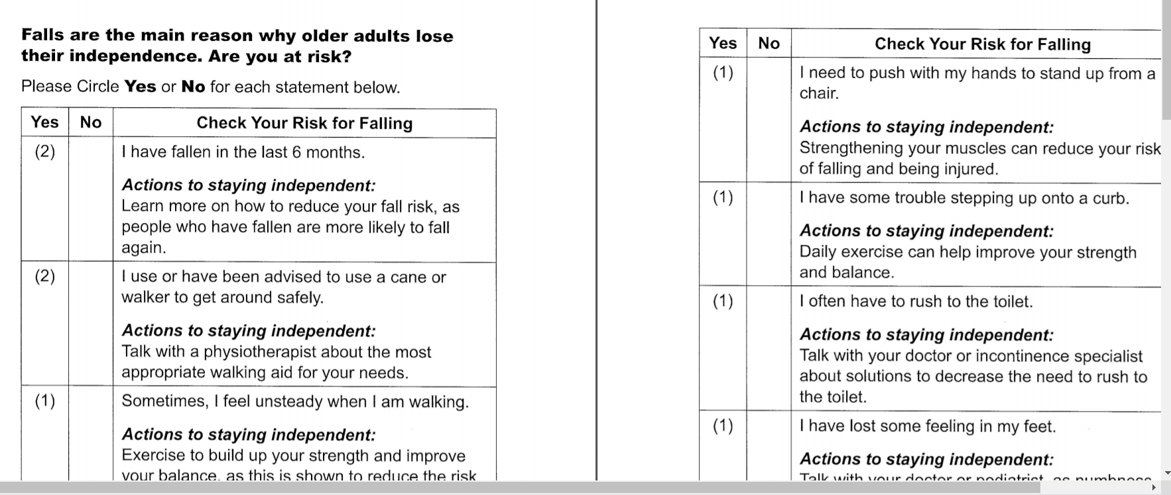
Example of Falls Self Assessment

Slide 13
CDC’s Still Going Strong Campaign
Introduced in May 2021
CDC’s Still Going Strong campaign speaks directly to older adults, age 65 and older, and their caregivers. We want to raise awareness about preventable injuries among older adults. This campaign has two goals:
Educate about common risk factors for falls and motor vehicle crashes, as well as traumatic brain injuries that happen from falls and motor vehicle crashes.
Empower older adults and their caregivers to take simple steps that will help them maintain their independence and age without injury.
Getting older doesn’t have to mean giving up the activities you enjoy!

Slide 14
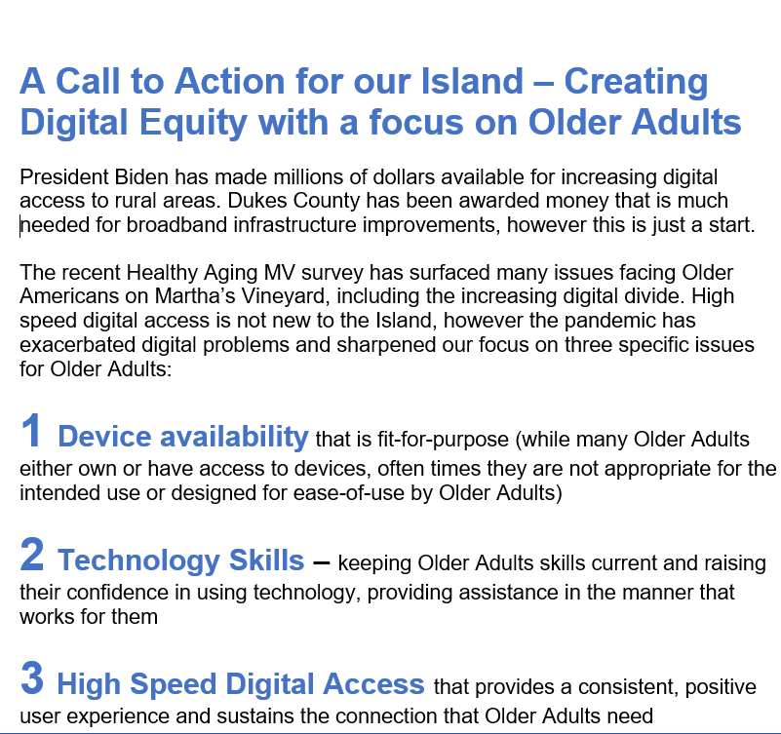
Update on Digital Equity Initiative
Since we’ve last met, this group has been focused on exploring how we can most effectively address the digital equity for Older Adults
Lessons learned:
There is much activity occurring on broadband access for rural areas by regulatory and advocacy groups
We believe we will be most effective addressing one of the 3 elements of the technology triangle (devices fit for purpose, technology skills and high speed digital access) – upskilling our Older Adults
We have a call-to-action as a next step to mobilizing as appropriate – we need you to weigh in and join this movement!

Slide 15
Home Safety Modification Program Metrics
Client Information | Nov, 2020 – July 2021 | August, 2021- Dec, 2021
Number of clients referred /applications completed | 24
Average age of clients & range | 80 average age (63-102)
Average income | $51,089
Location of clients - | Aquinnah - 2 Chilmark - 1 Edgartown - 6 Oak Bluffs - 3 Tisbury - 7 West Tisbury - 5
Household size | 1 – 9; 2 – 14; 3 - 1
% who qualified for full subsidy (100%) | 75%
% who qualified for partial subsidy ($100) | 8.33%
% who qualified for partial subsidy (20% of total) | 16.66%

Slide 16
Home Safety Modification Program Metrics
Program Status | Nov, 2020 – July 2021
Work completed | 14
Work to-be-completed (one client died before work started) | 7
Modifications fall outside program scope and referred to other programs | 2
Average project cost and range | $1,898 ($512 - $5,518)
Average time to complete work (from application to complete) | 3.2 months (2 -5 months)
Average age of home | 55 years

Slide 17
Home Safety Modification Program Metrics
Type of modification (completed projects) | % of participants
Grab bars | 79%
Stairwell Banisters | 64%
Outdoor Railings | 50%
Lighting | 14%
Smoke/fire detectors | 36%
Taping down rugs | 7%
Other | 36%
% who had outside work completed | 71%

Slide 18
Home Safety Modification Program Metrics
Survey results (pre/post) | % of participants
Reported falls on property before modification completed | 71%
Reported falls on property since modification completed | 0%
Ever treated for a fall either as an outpatient or hospitalized | 29%
Experience with project (strongly agree with the following statements)
-I was kept informed | 100%
-I was treated with respect by everyone | 100%
-Modifications made to my home have increased my safety | 100%
-I believe these modifications will allow me to stay in my home as I age | 100%
-I would recommend this program to my friends and homeowners who are 65 and older | 100%

Slide 19
Thought Starters for Getting the Word Out
Possible channels/partners
Newspaper article in 55+ section
Advertisement
COA, library newsletters
Radio/MVTV
MVH/patient gateway
Deliveries with meals on wheels
YMCA
Other fitness trainers/exercise programs
Who/what else?

Slide 20
Next Steps
Agreement on priorities
Sketching out September’s schedule
Sharing out assets with organizations serving Older Adults
How to get this done!

Slide 21
Falls Prevention Coalition 2021 Objectives and Work Groups

Slide 22
We’ve identified our focus areas for 2021
Education/Prevention
Strengthening healthcare connection
Improving safety in homes and our communities
Digital access
Metrics of Success
….and the work groups as well!

Slide 23
Updated Focus Area Work Groups
Education/ Prevention | Strengthening Healthcare Connection | Improving Safety in our Homes and Communities | Digital Access | Metrics of Success
Lead: Tanya Larsen | Lead: Thaddeus Thompson | Lead: Megan Panek | Lead: Betty Robie | Lead: Ian Campbell
Joyce Stiles-Tucker | Cindy Doyle | Catie Blake | Lorna Andrade | Bob Laskowski
Suzanne Robbins | Lori Perry | Cheryl Kram | Anne McDonough | Kathleen Samways
Valci Carvalho | Marina Lent | Victoria Haeselbarth | Cindy Trish
Lila Fischer | Lisa Hollander | Michele LeBlanc
Rose Cogliano

Slide 24
Education/Prevention Focus Area
Community education
Identifying the right content (and do we want to update our current brochure?)
Defining the audience
Communications campaign - frequency of messaging
Delivery Methods (print, digital TV, radio)
Falls Prevention Month (Sept) - how do we want to participate?
Prevention
An audit -what prevention programs currently exist on the island?
Investigation of evidence-based programs (including Matter of Balance which has gone quiet)
Selection and implementation of a prevention programs (if identified as a need)

Slide 25
Strengthening Healthcare Connections Focus Areas
Purpose: Leveraging the strengths and talents of all island organizations and increase the visibility of coalition
Map the connection points between different organizations for falls prevention/recovery (as an example, hospital care for a fall followed up by participation in a YMCA program)
Communicate and raise awareness of these connection points and coalition’s role
Use this knowledge to identify gaps and where the coalition can “lean in”

Slide 26
Improving Safety in our homes and communities focus areas
Advocacy, Awareness and Facilitation
Advocate for those who have a need for falls prevention efforts
Create awareness for programs/information to increase safety
Facilitation – bringing together different organizations to provide an integrated approach to improving safety (look for overlap with Disabilities Coalition)
Identify programs for the home – e.g. home audits
Look for “low hanging” fruit in the community

Slide 27
Digital Access Focus Area
Dedicated to improving safe, accessible, affordable digital access to Fall Prevention training, information, resources for older adults
Identify hardware and software needs and local resources available
Create local, (e.g. Disabilities Coalition and schools), state and national partnerships sharing this vision
Explore funding sources/implementation

Slide 28
Metrics of Success Focus Area
Create an annual message/story to demonstrate effectiveness
Stories (qualitative) of impact of falls prevention on community members – for each focus area of the coalition
1-2 standard metric (quantitative) tracked at the state level (TBD)
Economic savings from falls prevention (TBD)
Multiple modes of delivery (video, press releases, newspaper articles)
Identified Sources of information – a starting list
Screening data from the hospital (collected during wellness visits, falling history/likelihood of falling)
Home Safety Modification Program pre/post survey data
Older Adult 2020 Survey data, EMS data, what else?

Slide 29
Current Falls Prevention Coalition Members*
Broad representation from island organizations but always room for more!
Lorna Andrade, drlorna.andrade@hotmail.com
Catie Blake, cfuller@tisburyma.gov
Ian Campbell, ICAMPBELL4@partners.org
Valci Carvalho, vcarvalho@partners.org
Leslie Clapp, lesliec@mvcenter4living.org
Rose Cogliano, rcogliano@oakbluffsma.gov
Cindy Doyle, cdoylema@me.com
Lila Fischer, lfischer@ihimv.org
Victoria Haeselbarth, vhaeselbarth@edgartown-ma.us
Lisa Hollander, lisahollander@comcast.net
Cheryl Kram, ckram@capecodhealth.org
Tanya Larsen, coa-staff@westtisbury-ma.gov
Bob Laskowski, laskowskiadvisors@gmail.com
Michele LeBlanc, mleblanc@mvcommunityservices.org
Marina Lent, boh@chilmarkma.gov
Anne McDonough, amcdonough@clamsnet.org
Megan Panek, megan.panek@escci.org
Lori Perry, lperry@ihimv.org
Betty Robie, brobie@ymcamv.org
Suzanne Robbins, SROBBINS5@partners.org
Kathleen Samways, ksamways@ihimv.org
Joyce Stiles-Tucker, jstucker@tisburyma.gov
Thaddeus Thompson, tthompson3@partners.org
Cindy Trish, ctrish@hamv.org
Updated 8/2021

