Slide 1


MV Falls Prevention Coalition 2021 Kick-off
2021 Kick-off meeting agenda:
*Welcome and introduction of new members
*A quick review of 2020 accomplishments
*Creating our “vision” for 2021
*How to make it happen
Jan 19, 2021
Thank you for joining us!

Slide 2

Current Falls Prevention Coalition Members
Broad representation from island organizations but who is missing?
Joyce Albertine, coa-director@westtisbury-ma.gov
Lorna Andrade, drlorna.andrade@hotmail.com
Catie Blake, cfuller@tisburyma.gov
Valci Carvalho, vcarvalho@parnters.org
Rose Cogliano, rcogliano@oakbluffsma.gov
Dianne Durawa, dvdmv@hotmail.com
Lila Fischer, lfischer@ihimv.org
Victoria Haeselbarth, vhaeselbarth@edgartown-ma.us
Richard Huffman, RHuffman@mvhospital.org
Bob Laskowski, laskowskiadvisors@gmail.com
Tanya Larsen, coa-staff@westtisbury-ma.gov
Thaddeus Thompson, MVH, tthompson3@partners.org
Deborah MacInnis, deb.snow.mac@gmail.com
Allyson Malik amalik@clamsnet.org
Paddy W. Moore, mooreiipaddy@gmail.com
Megan Panek, megan.panek@escci.org
Lori Perry, lperry@ihimv.org
Alexandra Pratt, apratt@clamsnet.org
Betty Robie, banson50@aol.com
Suzanne Robbins, SROBBINS@parnters.org
Amy Ryan, amyryan@clamsnet.org
Kathy Samways, ksamways@ihimv.org
Myra Stark, quilt185@comcast.net
Joyce Stiles-Tucker, jstucker@tisburyma.gov
Ian Campbell, ICAMPBELL4@partners.org
Cindy Trish, ctrish@hamv.org

Slide 3
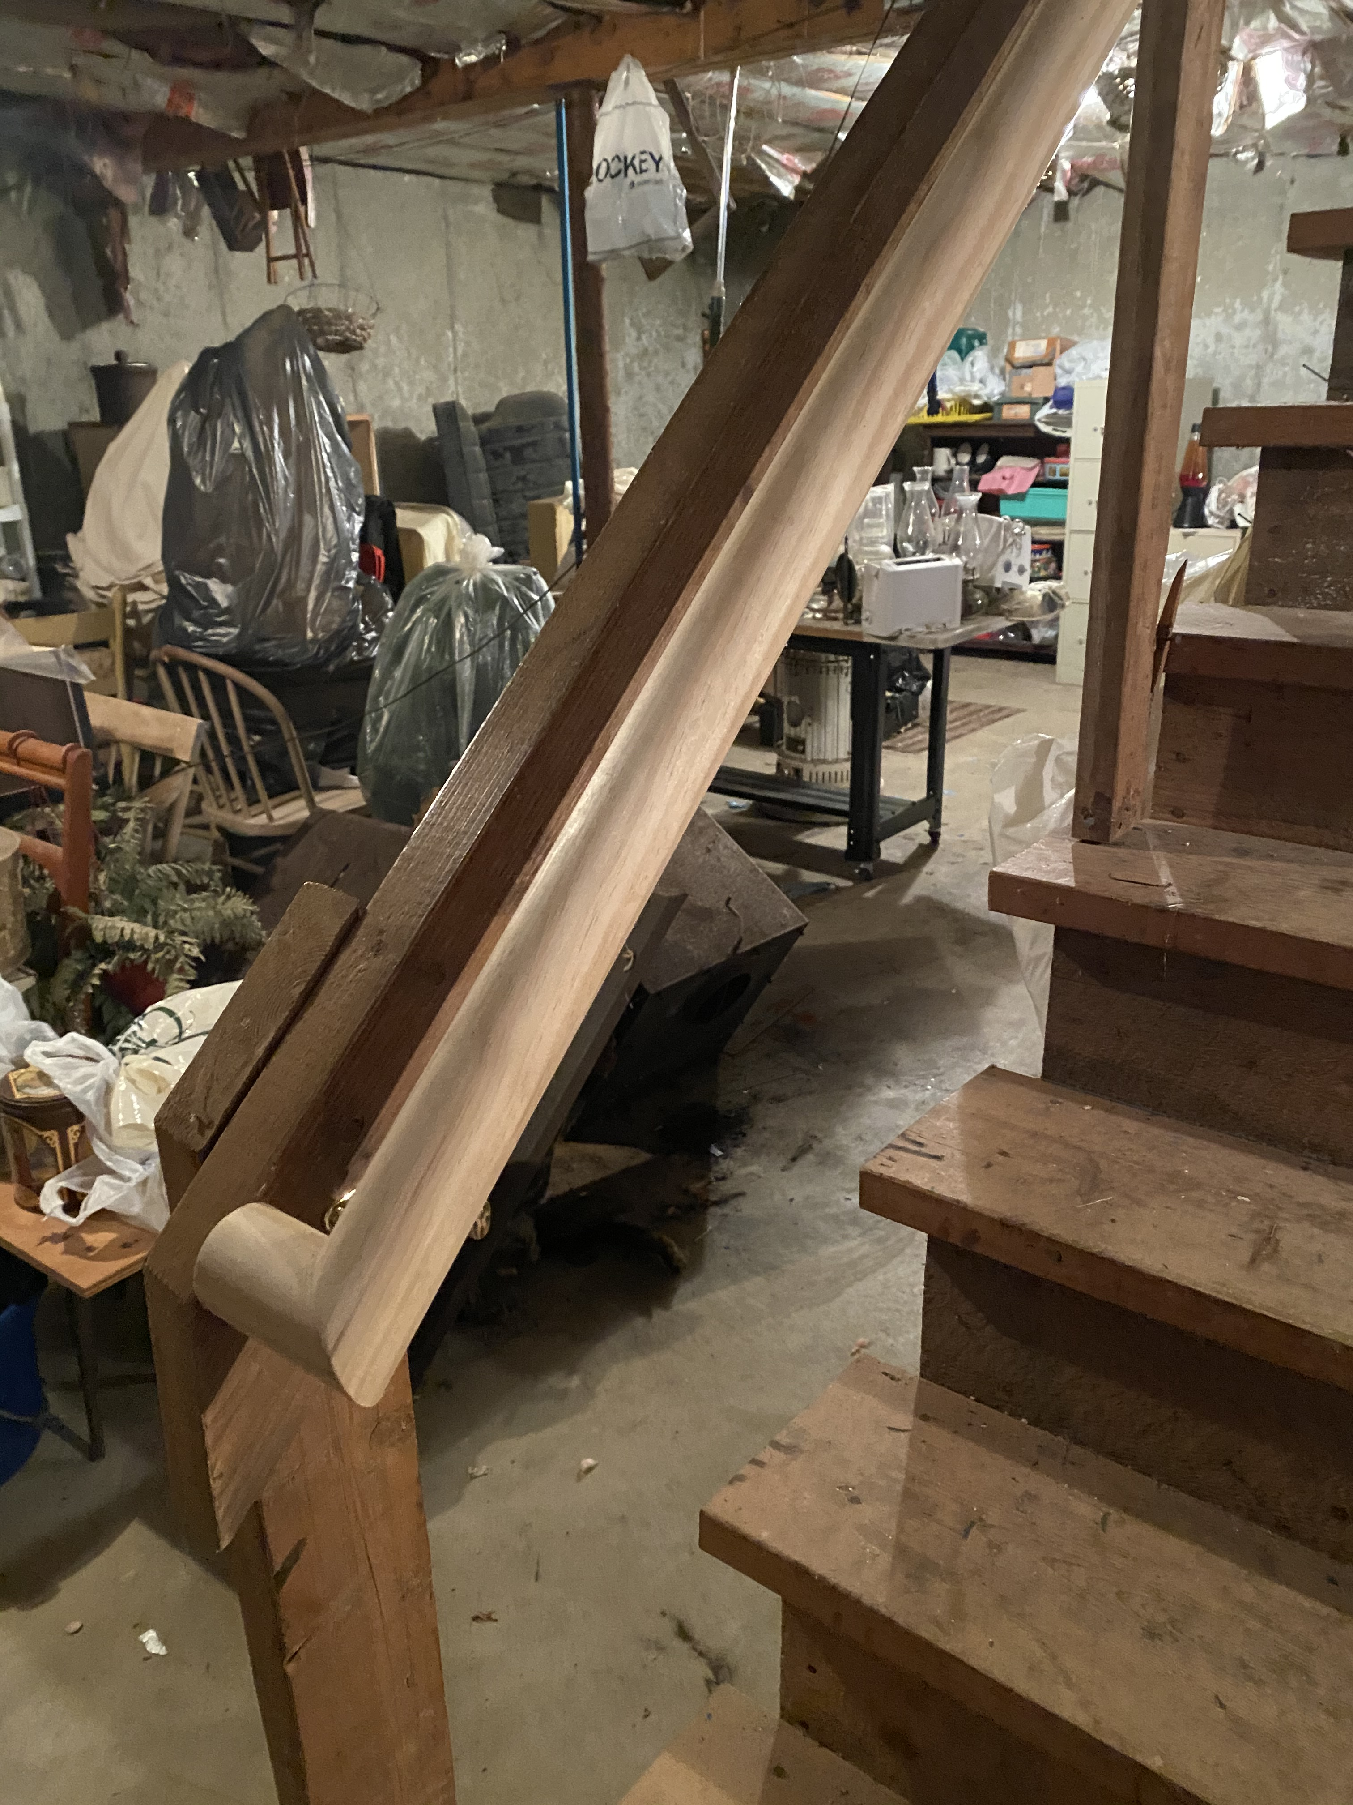
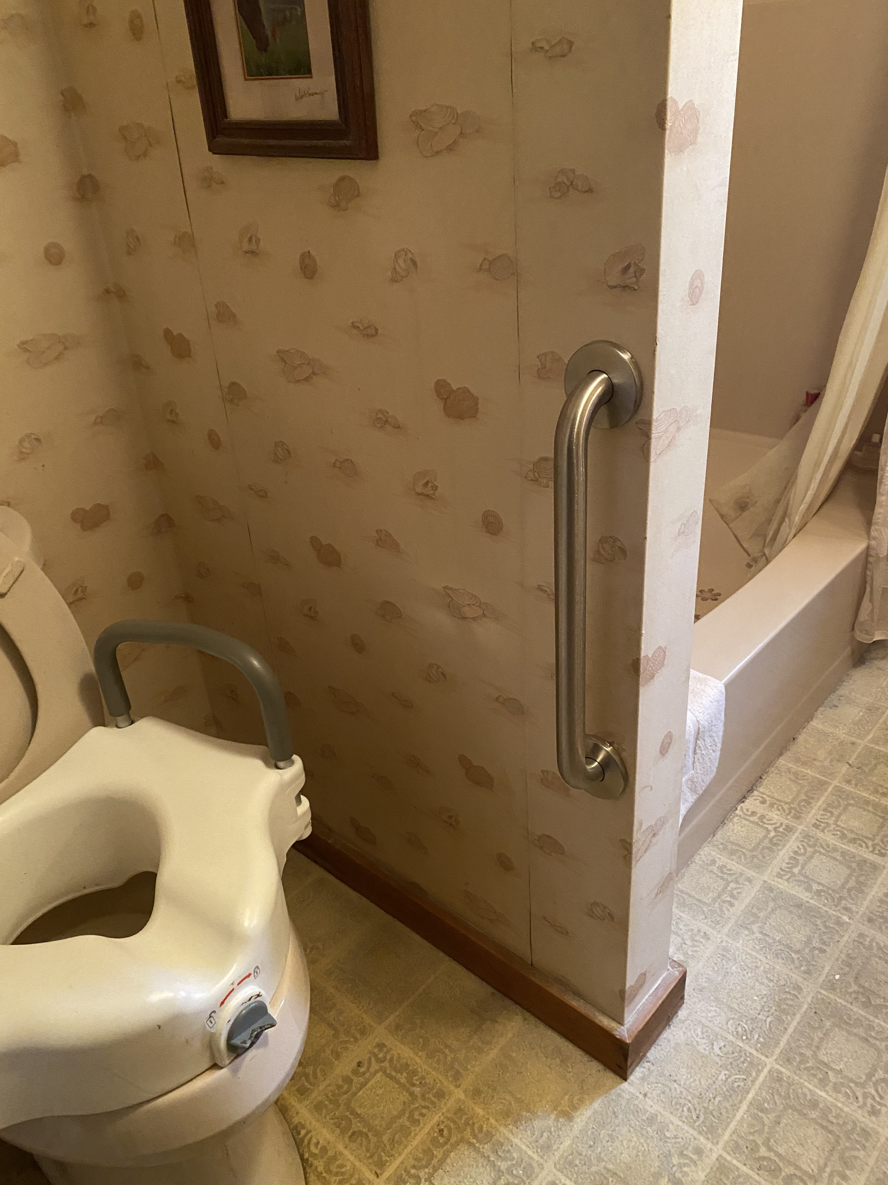
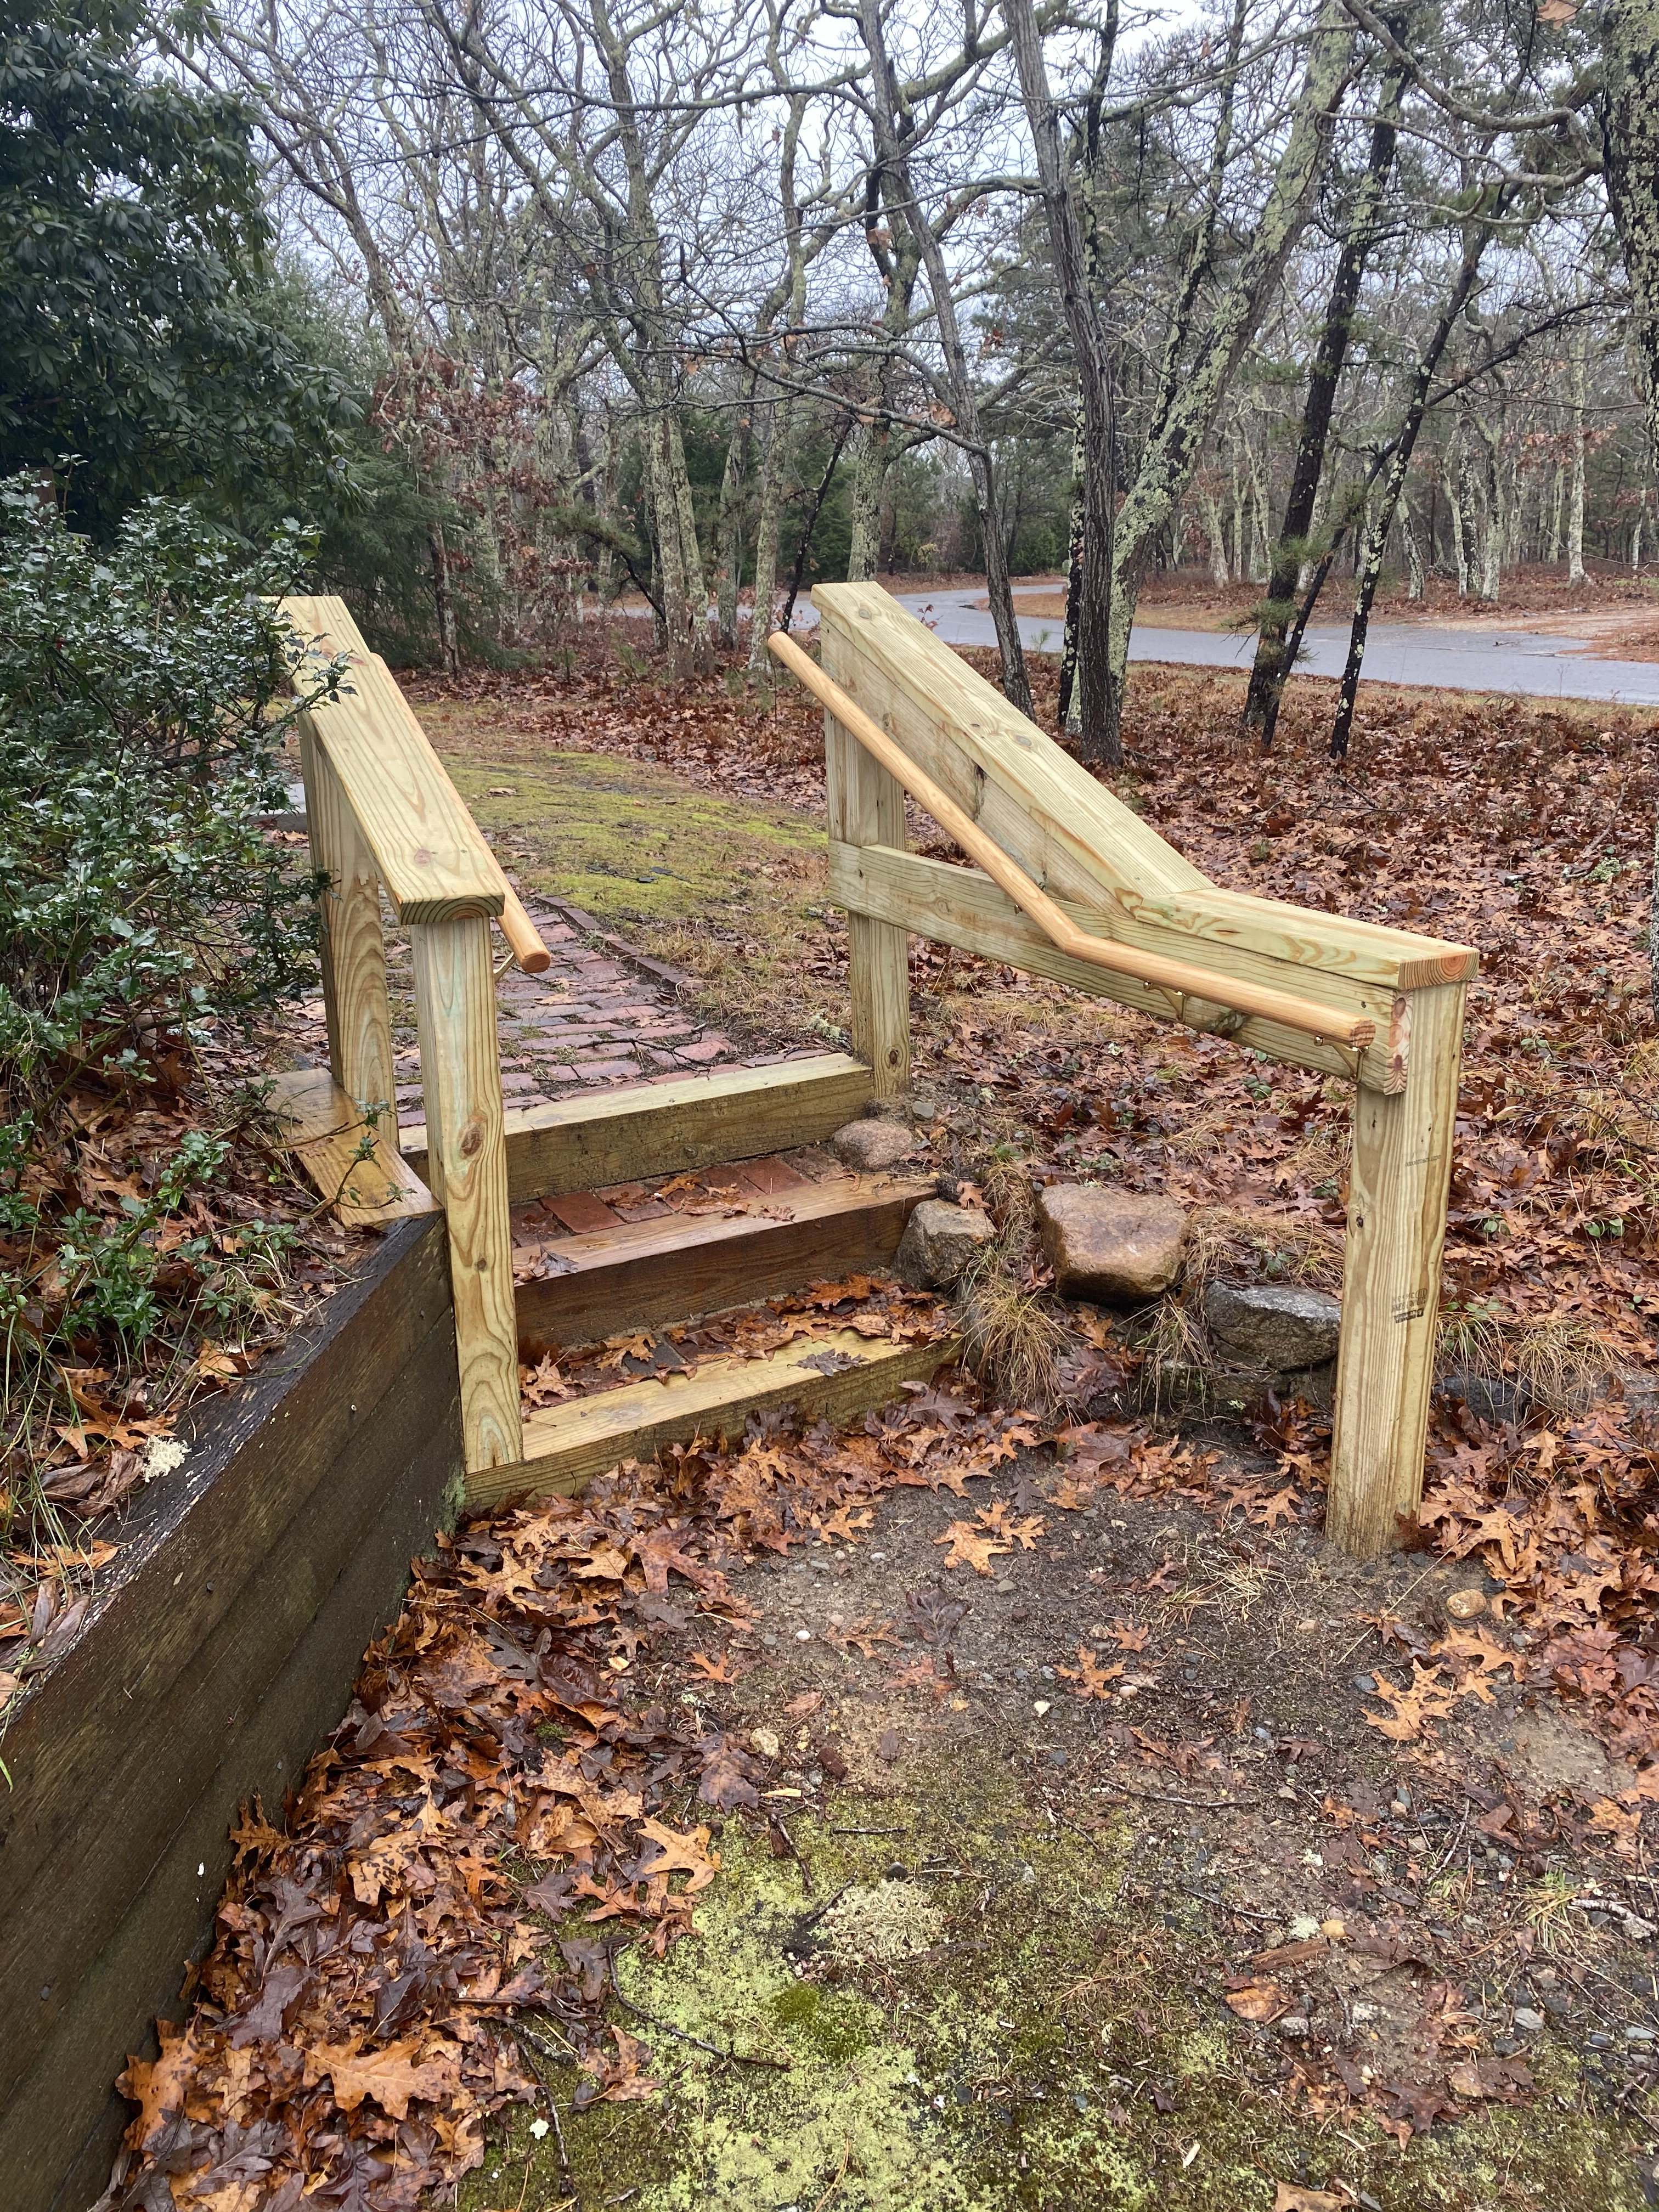
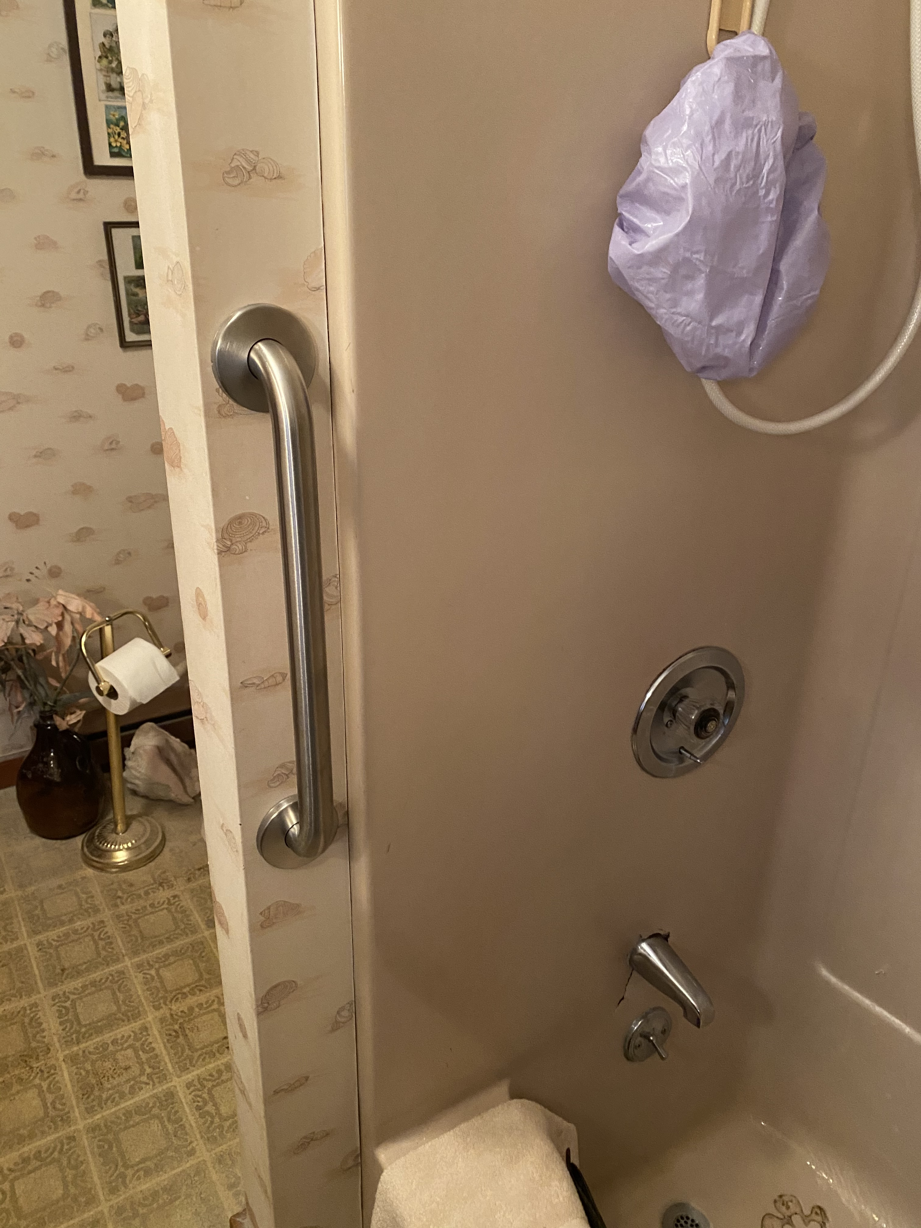
2020 Coalition Review – Update on Housing Safety Modification Pilot Program
9 participants enrolled currently
Improving our process as we go
Network of referral agencies growing
Work continues under COVID regulations
Additional funding from MVSBCF

Slide 4
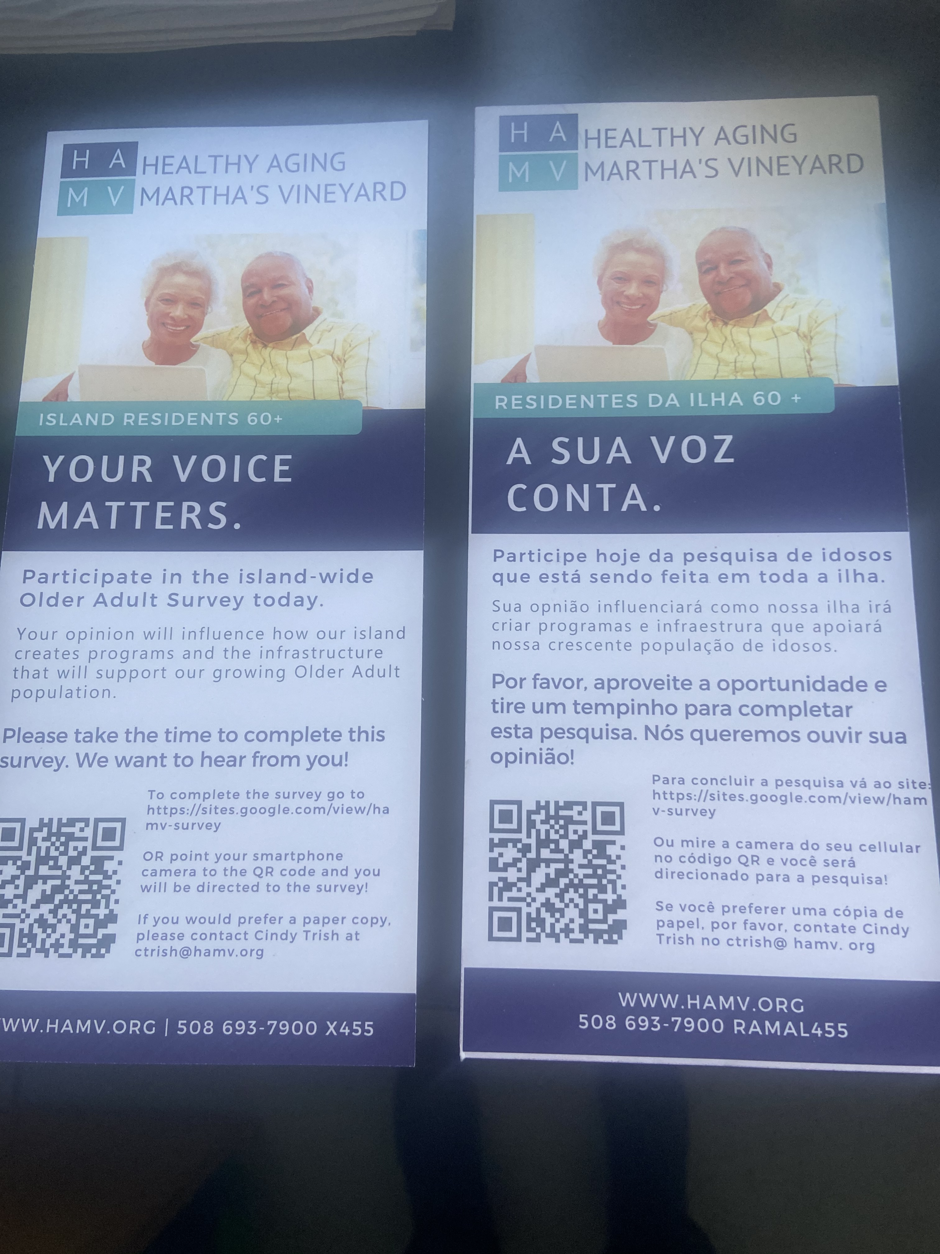
2020 Coalition Review Island-wide Older Adult Survey is complete
Almost 2,500 completes
Includes a question about falling in the last year
Interest in home safety modifications
Analysis underway –data will be available in Q1

Slide 5
2020 Coalition review continued
Communication focus was on “staying safe in our homes”
Multi-communication campaign for Falls Prevention Week (MVTV, MVY Radio, newspaper, PSAs, island-wide delivery of falls prevention brochure via COAs, Food Pantry, Meals-on-wheels)
What else can you share about your falls prevention efforts in 2020?

Slide 6
Our vision for 2021
COALITION:
an alliance for combined action
The word coalition connotes a coming together to achieve a goal.
What do we want to accomplish?
How will we measure our success?
How do we want to work together?

Slide 7
What do we want to accomplish?
COALITION:
an alliance for combined action
The word coalition connotes a coming together to achieve a goal.
Focus areas could include:
Education
Prevention
Strengthening healthcare connection
Staying active
Improving safety in homes and our communities

Slide 8
How do we want to work together?
COALITION:
an alliance for combined action
The word coalition connotes a coming together to achieve a goal.
Committees/work groups for each priority?
Frequency of coalition meetings for 2021
Exploring funding sources?

