Slide 1
Older Adult Transportation Initiative
Agenda:
Introductions
Updates
*Transportation Landscape
*What other Rural Communities are doing
*Consumer Data
Creating our Needs Hierarchy
*Discussion
*Needs Hierarchy Defined
*Next Steps
March 24
Thank you for joining us!

Slide 2
2020 Older Adult Survey – a snapshot of our island
Almost 2,500 60+ respondents completed a survey (online or paper) from Oct, 2020-Jan, 2021 – 66 questions.
Balanced representation from all towns (averaging a 30% response rate).
Vast majority (>90%) identify as permanent with 75% reporting “living on island for 12 months in 2019”.
Representation from all age ranges with 15 surveys completed by 95+.
*Question 56 (Dec, 2020 HAMV survey)

Slide 3
More on our Older Adult participants
Almost two thirds of Older Adults report an annual household income of $100k or less
Slightly more female participants (60% versus 38.8% male)
12% are veterans
Race/ethnicity mix in-line with known population statistics for the island (.2% identified as Brazilian)

Slide 4
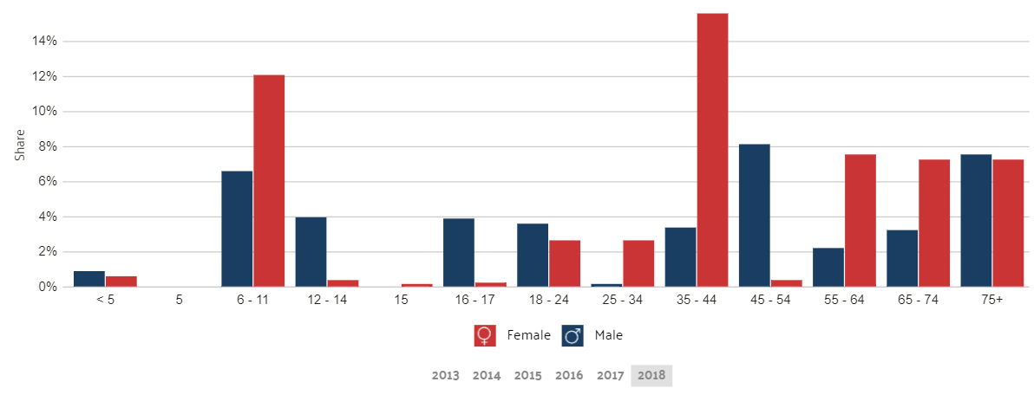
Dukes County Poverty Level by Age Group*
Average Household Income | $134,549.14
Median Household Income | $87,126.00
People below Poverty Level | 1,371
People above Poverty Level Median Household income for 65+ $64,434 | 16,362
25-44 Age: Household Median Income = $78,178
Data source: Data USA
sss

Slide 5
We see ourselves as (relatively) healthy and valued
9 in 10 older adults rate their overall physical, oral and mental health as excellent or good as compared to “most people your age” .
However, 20% report mobility issues.
The vast majority of older adults, regardless of age, feel valued by the Vineyard community.
The responses to these 2 questions are almost identical to the 2015 survey responses.
*Question 40 & 41 (Dec, 2020 HAMV survey)
The Vineyard community values the opinions and thoughts of our older adults*

Slide 6
Some Older Adults are actively engaged with varied interests
Question 15 (Dec 2020 HAMV survey)
Activities | % of those currently participating | % who are not currently participating who would like to
group exercise/fitness programs | 22% | 29%
group outdoor activities (hiking, biking fishing etc.) | 21% | 22%
arts/crafts/gardening | 8% | 29%
Community leisure activities-bridge, chess, etc. | 13% | 20%
Youth programs – tutoring, mentoring, coaching | 3% | 18%
Programs helping other seniors such as Meals on Wheels | 6% | 22%
Caregiver support group | 2% | 11%
Religious or Spiritual organization | 20% | 10%
Hands-on volunteer a for non-profit or charity | 18% | 21%
Volunteer for town or regional committee or taskforce | 10% | 15%
Serving as a non-profit or charity board or committee member | 16% | 13%
Community outreach/advocacy | 5% | 10%
Attending lectures, performances, art shows, author talks etc. | 34% | 26%
Enrichment educational programs, such as a foreign language, etc. | 9% | 25%

Slide 7
Older Adult volunteer contribution is meaningful and increasing
Volunteer Hours per week | 2015 | 2020
<5 hours per week | 27% | 36%
6-10 hours per week | 8% | 12%
>10 hours per week | 4% | 6%
Volunteer contributions equate to:
Equal to an equivalent of workforce 500+ full-time employees
With an economic value of $28M*
Older adults of all age ranges, genders, income levels, veteran status, and ethnicities are similarly engaged
Question 16 (Dec, 2020 HAMV Survey)
*The Independent Sector -a nationally recognized source of information and data relative to nonprofits provides a metric of $27.20 per hour to determine the monetary value of a volunteer.

Slide 8
Our cars = Our lifeline
9 in 10 island older adults report that they “often” drive themselves and continue to do so as they age.
It isn’t until 85+ that the % of those who “never drive myself” begins to increase (and rely on others to drive them).
By 95+, a minority are still driving themselves “often”.
*Question 30 (Dec, 2020 HAMV survey)
But driving is more than just a passion or a pastime: It’s a lifeline. Studies show that giving up driving increases a person’s mortality risk and makes seniors more likely to land in nursing homes and suffer from depression. (Michael Tortorello, June, 2017)

Slide 9
Drive, walk or bike with minimal usage of other forms of transportation
1 in 2 older adults report that they “often” walk, and when those who walk “some of the time” it increases to 8 out of 10.
A sizable number (>30%) of older adults also report biking “often” or “some of the time”.
Other forms of transportation are used infrequently or not at all by most older adults.
*Question 30 (Dec, 2020 HAMV survey)

Slide 10
Income impacts transportation mode mix
<$25k households drive themselves less often than all other income levels
Are more likely to rely on other transportation modes
And more often found transportation options delayed or unavailable in COVID (21% often/sometimes versus 5% for >$200k)
*Question 30 & 45 (Dec, 2020 HAMV survey)

Slide 11
Infrastructure importance aligns with transportation preferences of Older Adults as well as access to nature
Question 28 (Dec, 2020 HAMV Survey)

Slide 12
While the majority don’t report problems with infrastructure, a quarter cite road maintenance, parking, sidewalks and bike paths as issues
Question 28 (Dec, 2020 HAMV Survey)

Slide 13
Where you live does matter when it comes to how you feel about your transportation infrastructure
Aquinnah and Chilmark residents cite problems with sidewalks more often than others
Vineyard Haven and Oak Bluffs residents are more likely to report road maintenance and parking problems
And those with the highest income ($201k+) most frequently cite problems with bike paths
“I think accessibility is a key. There are lots of easy fixes and now is the time”
“As a caregiver for a wheelchair-bound spouse, I find brick sidewalks particularly difficult”
“Seasonal issue. Parking miserable in summer, bike paths essential for safety on crowded roads”
Question 28 (Dec, 2020 HAMV Survey)

Slide 14
Increased demand for transportation services is looming and age-related
As Older Adults age, they are more likely to have experienced difficulty in receiving transportation services
The demand for transportation services across all ages will increase
 | Total | 60-64 | 65-69 | 70-74 | 75-79 | 80-84 | 85+
No need currently for service* | 51.90% | 63.70% | 58.40% | 52.60% | 50.70% | 39.10% | 27.60%
Present difficulty in receiving transportation | 4.30% | 1.90% | 2.00% | 2.60% | 4.70% | 7.30% | 15.30%
Need for transportation in the next 2 years | 14.70% | 7.90% | 7.40% | 10.50% | 17.10% | 27.70% | 47.00%
Question 48 (*does not apply to me) HAMV 2020 Survey

Slide 15
Income and gender also impact usage/need of transportation services
Lower income Older Adults have more need now and in the future
Women are more likely than men to have a need for transportation
 | Total | <$25k | $25-$50k | $51-$100k | $101-$150k | $151-$200k | $201k+
No need currently for service* | 51.90% | 35.10% | 47.50% | 53.10% | 51.60% | 57.60% | 54.20%
Present difficulty in receiving transportation | 4.30% | 17.20% | 8.60% | 2.20% | 1.60% | 0.00% | 1.10%
Need for transportation in the next 2 years | 14.70% | 29.70% | 23.00% | 13.50% | 11.60% | 4.90% | 5.10%
Question 48 (*does not apply to me)
Dec 2020 HAMV Survey

Slide 16
Older Adults express interest in other transportation options
4 in 10 are “almost certainly” or “may” use additional VTA fixed routes (closer to home) if available – more than twice the number of older adults who report current usage of the VTA.
Lower income households are more likely to consider new alternative transportation options.
Common theme of greater convenience resonated with older adults (closer to home, on demand etc.).
Limitations of current bike paths a sore
point for older adults and impacting usage.
*Question 31 (Dec, 2020 HAMV survey)

Slide 17
Older Adult Transportation Takeaways
Drive until you don’t
When you don’t drive, self propel (walk and bicycle)
Income impacts transportation mode mix, need and lesser so age
Limited usage of alternative transportation modes
Some recognition that current solutions may not be adequate for the future as physical, mental, and economic situations may change
Focus is on moving bodies, not goods

Slide 18
Older Adult Takeaway Implications
Current transportation practices of Older Adults add to the strain of our road infrastructure/traffic challenges/environment
Reliance on walking and bicycling raise importance of sidewalks and bike trails
Transportation costs (as percentage of disposable income) creates strain on other essential needs and requires additional community support
There is a need greater awareness and education of alternative transportation options in the case of changing circumstances

Slide 19
What Consumer data tells us about transportation needs
Older Adults Aspire to be:
Self-sufficient
Independent
Socially connected
Engaged with family, friends and the community
Transportation Elements:
Essential & Enrichment
Scheduled & Unscheduled
On-island/off-island
Solution Guardrails:
Available
Easy-to-Use
Accessible
Reduces overall transportation costs
Adaptable

Slide 20
Discussion questions
What other transportation elements need to be included?
What other attributes should be in our guardrails?
Where are the biggest gaps in transportation solutions today?
What should be our priority focus areas?
Bonus Question:
How do we involve Older Adults in the transportation solution?

